Slide 1
OSS Final Report
Team 1
TITLE
Scrum Master: Amelia Mazer
Product Owner: Rahul Sridhar Bangalore

Slide 2








Our Team - Git Mavericks
TITLE
Amelia Mazer
Scrum Master
Rahul Sridhar Bangalore
Product Owner
Vinit Jahagirdar
Software Engineer
Yunus Kocabey
Software Engineer
Jonas Hernando
QA Engineer
Xinyu (Tina) Zou
QA Engineer
Thao Nguyen
Support Engineer
Jingyu (Charlie) Xu
Support Engineer

Slide 3
Table of Contents
01
Our Company
02
About Git
03
Our Approach to Change
04
Appendix
TITLE
IntelliPrice and our current practices
Why the switch?
Supporting slides
Our “How?”
3a. Requirements & Personas
3b. Planning
3c. Architecture and Design
3d. Testing
3e. Release

Slide 4
01
Our Company
TITLE
“The function of good software is to make the complex appear to be simple.” - Grady Booch [1]
[1] https://www.azquotes.com/quote/602639

Slide 5
IntelliPrice
SIMPLE
Founded: 2010
Employees: 100
Headquarters: San Jose, CA
Mission Statement: We make your price right for you so you can achieve pricing success with confidence and ease.
IntelliPrice is on a journey to make e-commerce product pricing simple. We provide cloud-based price optimization solutions, which assist small-to-medium-sized businesses with automating their pricing either fully or partly by leveraging machine learning and advanced algorithms. Our solution features include:
- Competitor Pricing Analysis
- Revenue Tracking, Process Automation
- Product Management
- User-friendly Portal

Slide 6
Our Problem
SIMPLE
IntelliPrice currently uses Apache Subversion (SVN) as its version control software. SVN’s limitations began to show during the COVID-19 pandemic when our teams were working remotely. SVN’s centralized workflow led to a decrease in cohesion amongst developers. This led to errors and duplication of efforts, ultimately decreasing productivity and prolonging development time. Our company has also shifted more towards remote work, and trying to work SVN, a Centralized Version System (CVS) to behave more akin to a Distributed Version System (DVS) is projected to be expensive to implement.
Recent Issues:
Increase in lead time of major product releases by an additional five weeks on top of our average four-month cycle.
Decrease in employee productivity due to merge conflicts and breakdown in communication between teams.
Takeaway: IntelliPrice’s use of a CVS has hampered its ability to maintain cohesion between developers, and has led to instances where work cannot be conducted due to unexpected downtime.

Slide 7
Hypothesis
SIMPLE
Using a DVS (Git) is better than a CVS (Apache Subversion) in terms of collaboration among developers and in terms of cost due to the following reasons:
Distributed Version Control: Git, even with a steeper learning curve, will work to enable us to manage our code more efficiently, collaborate and deliver software updates on schedule for our organization’s work altogether in delivering a valuable product. With a DVS, we could ideally cut the average time it takes to release a major product from 4 months with SVN to 1 month with Git. [1]
Collaboration: We hope to see real benefits in its ability for developers to work offline, and allowing for each developer to work on their own piece of code to be staged for merge will enhance productivity and reduce conflict between team members.
Branch protection: A distributed version control model will help to eliminate the single point of failure, and will allow our work to continue unimpeded in the case of downtime.
Cost: Based on our cost analysis, It would be more cost-effective to migrate our workflow to Git by at least 30% more than attempting to modify SVN to behave like a DVS. Using SvnX as an SVN client to view revision history has cost an average of $2,747.00 per employee per year to train them on SVN, especially as our headcount increases. SVN does not have a main support team, so we must higher consultants. [2]
[1] From SVN to Git: how Atlassian made the switch without sacrificing active development. Jonathon Creenaune. January 3, 2013. Retrieved from: https://www.atlassian.com/blog/git/svn-to-git-how-atlassian-made-the-switch-without-sacrificing-active-development
[2] ATD Report Releases 2016 State of the Industry. Retrieved from: https://www.td.org/insights/atd-releases-2016-state-of-the-industry-report

Slide 8
Business Case and Pain Points
SIMPLE
In our current workflow, our developers must always have a network connection, and work on software updates and bug fixes on branches before merging to the main trunk.
[1]
Performance and Scalability | Work Disruptions/Single Point of Failure | Collaboration and Streamlined Development | Increase in Project Costs
With SVN, our developers can only pull specific files from the central repository to their local machines, and in order to conduct unit testing, will either have to do so in isolation or commit the changes back to the central repository. This multi-step process, on top of always having to be connected to the repository, has slowed down our developers’ ability to conduct testing by on average 2-3 weeks. | SVN has no offline functionality, and therefore always requires that our developers be connected to the central server. If our developers are not connected, work ceases entirely, which has prolong. Work also ceases if the central repository is down, so SVN creates a single point of failure for us as no changes can be made until the central repository is back online. For a project that was meant to be completed in four months, unexpected downtime delayed the release by another five weeks. | SVN’s top-down approach has led to a breakdown of cohesion, and merge conflicts. First, since SVN requires new code to be committed to the central repository, as such, our developers often go days and weeks without committing new code out of fear that the commit will ruin the build. Second, SVN does not resolve merge conflicts effectively. Since SVN only considers revisions rather than history, conflicting code commits will be messily fused together, which has cost teams weeks of work to try and resolve. | With SVN, we currently spend up to 15% of R&D team time working on debugging messily merged branches. This has cost IntelliPrice $132,500 per year on average just on addressing SVN’s merge conflicts.
[1] Subversion Re-Education: https://web.archive.org/web/20180909115459/http://hginit.com/00.html

Slide 9
Competitive Analysis
SIMPLE
Business Objective: Improve collaboration amongst developers, maintain productivity with remote work, put out timely releases of software updates and bug patches, and reduce project costs.
Technology Selection Criteria | Git | Apache Subversion (SVN) | Mercurial
Distributed vs Centralized | Decentralized distributed repo model. In other word, Git is a repo with lots of client repos, each with a user | Centralized repo model. In other word, SVN is one repo with lots of clients | Decentralized distributed repo model. In other word, Git is a repo with lots of client repos, each with a user
Performance | Known for its speed and performance. Since every user has a local copy of the repo, most operations are performed locally, making it fast and efficient. | Requires frequent communication with the central repository, which can result in slower performance, especially for large repositories or when working remotely. | Similarly to Git, Mercurial is also known for speed and performance due to its decentralized nature
Learning curve | Steep learning curve, as it has a more complex and powerful feature set. Command-line interface by default and the command sets can be daunting. [3] | Short learning curve as it has simpler feature set [2] | Less steep than Git. Command-line by default, but the commands and terminology are generally more intuitive than Git [1]
Community and ecosystem | Largest active communities of users and contributors, with ecosystems of wider range of tools, plugins, and integrations with other development tools. | A community of users and contributors exists. However, its adoption has been trending downwards due to many projects migrating to distributed SCM solutions [4] | Smaller user base than Git with not as extensive ecosystem of tools, plunges, and integration with other development tools
Branching and Merging | Branching and merging in git are lightweight and flexible with powerful algorithms that can handle merge conflicts. | Branching in SVN is complex and it requires developers to create a copy of the entire repository each time. | Mercurial’s branching model can cause confusion and the merging algorithm is simpler than Git’s algorithm and may require manual intervention.
Network Protocols Supported | HTTP/HTTPS, SSH and GIT protocol. | SVN & SSH | HTTP/HTTPS or SSH
[1] Mercurial vs Git: How Are They Different?, Chuck Gehman, January 9, 2019. Retrieved from: https://www.perforce.com/blog/vcs/mercurial-vs-git-how-are-they-different
[2] Git vs. SVN: What is the Difference?, Git at Scale, November 14, 2018. Retrieved from: https://www.perforce.com/blog/vcs/git-vs-svn-what-difference#:~:text=The%20biggest%20difference%20between%20Git,to%20take%20these%20into%20account.
[3] Version control software comparison: SVN, Gut, Mercurial. Retrieved from: https://www.timedoctor.com/blog/git-mecurial-and-cvs-comparison-of-svn-software/
[4] 15 BEST Version Control Software (Source Code Management Tools). March 21, 2023. Retrieved from: https://www.softwaretestinghelp.com/version-control-software/#10_IBM_Rational_ClearCase

Slide 10
02
About Git
TITLE

Slide 11
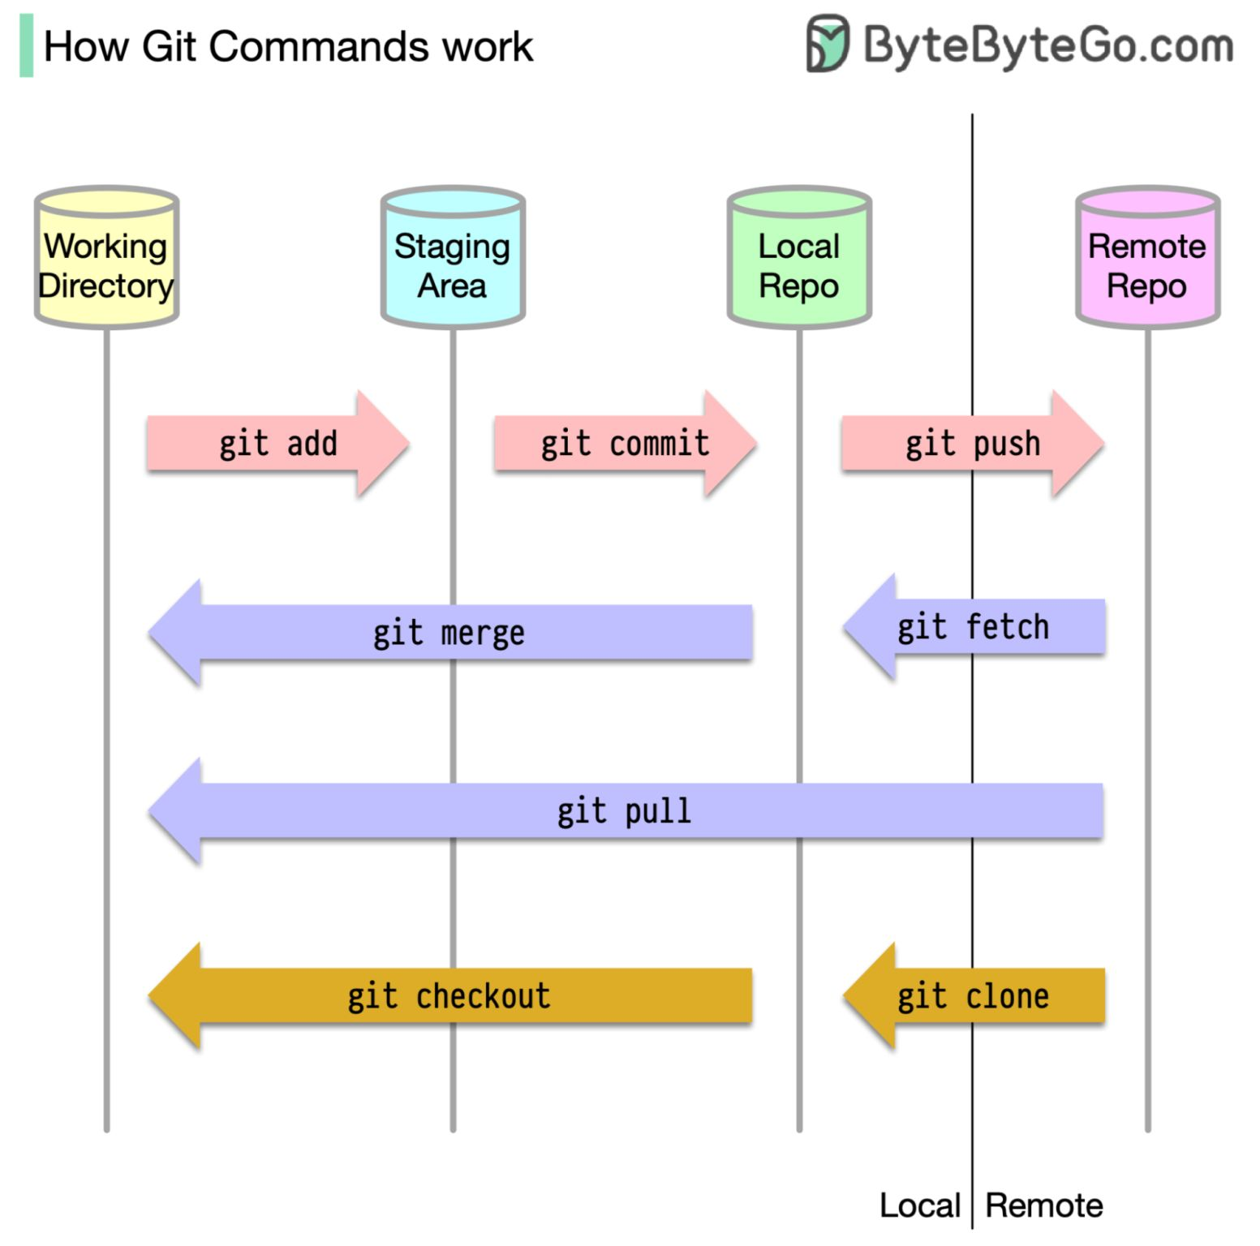
Key Git Concepts
SIMPLE
^{[1]}
^{[2]}
Local Repository: Git provides a private copy of the entire repository. Users can add, remove, rename, move, and commit changes.
Working Directory and Staging Area or Index: The working directory is where files are checked out. Git only tracks files in the staging area during commit, not all modified files.
Commits: Commits are created with the git to capture the state of a project at that point in time.
Branches: Branches are used to create another line of development. Git has a master branch by default. A branch is created to work on a new feature, then merged back with the master branch.
Clone: Clone creates a local repository instance to perform operations on. Networking is only involved when synchronizing repository instances.
Pull: Pull copies changes from a remote repository instance to a local one, synchronizing them.
Push: Push copies changes from a local repository instance to a remote one, permanently storing them in the Git repository.
[1] Git Key concepts image retrieved from: https://www.linkedin.com/feed/update/urn:li:activity:7056202268383010818?utm_source=share&utm_medium=member_desktop
[2] Definitions of key Git concepts retrieved from: https://www.tutorialspoint.com/git/git_basic_concepts.htm

Slide 12

Sponsors
SIMPLE
Git is developed and maintained by a community of volunteers. The project is funded by donations from individuals and companies, and it is hosted on GitHub.
There are a number of companies that use Git internally and contribute to the project. These companies include Google, Microsoft, Amazon, IBM, Red Hat, Intel, Cisco, VMware, Docker, and Travis CI. The contributions of these companies help to ensure that Git remains a leading version control system.
^{[1]}
^{[2]}
[1] Google Open Source Blog. 2022, June. https://opensource.googleblog.com/2022/06/
[2] Image from Git website. https://git-scm.com/

Slide 13
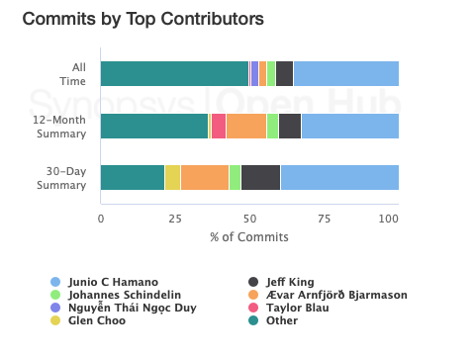
Contributors
SIMPLE
Linus Torvalds turned over maintenance on 26 July 2005 to Junio Hamano, a major contributor to the project.
Hamano is currently the top contributor.
^{[1]}
Contributors All Time Rankings (by number of Commits)
Junio Hamano
Jeff King
Johannes Schindelin
Ævar Arnfjörð Bjarmason
Nguyễn Thái Ngọc Duy
Taylor Blau
Glen Choo
^{[2]}
[1] Chacon, S., & Straub, B. (2014). Pro git. Apress. https://git-scm.com/book/en/v2/Getting-Started-A-Short-History-of-Git
[2] Graph from Synopsys Open Hub. https://www.openhub.net/p/git/contributors/summary

Slide 14



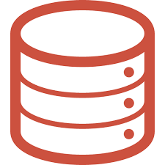




Upstream and Downstream
SIMPLE
Git has upstream and downstream concept in itself. We can explain these concepts using Git’s structure. The diagram below shows how a Git project can be an upstream for another project;
Many companies utilize downstreams of Git.
Some of the downstreams are as follows;
Upstream
Downstream
Remote
Remote
[1]
[2]
You can Clone to your computer from Origin
Git
GitHub
GitHub is a code hosting platform for version control and collaboration. It lets you and others work together on projects from anywhere.
[5]
Fork
Upstream
Upstream
Origin
Upstream
Downstream
[3]
You can Pull from upstream changes to original
You can Push and Pull to your fork origin
Downstream
Git
GitLab
GitLab is an open source code repository and collaborative software development platform for large DevOps and DevSecOps.
[6]
Upstream
Downstream
[4]
[8]
Git
Bitbucket
Local
Bitbucket Cloud is a Git based code hosting and collaboration tool, built for teams.
The downstream repository refers to a repository that has been cloned or forked from the upstream repository.
[7]
[1] Image from Git website. https://git-scm.com/downloads/logos
[2] Image from Github website. https://github.com/logos
[3] Image from GitLab website. https://about.gitlab.com/press
[4] Image from Bitbucket website. https://bitbucket.org
[5] Hello World. https://docs.github.com/en/get-started/quickstart/hello-world#
[6] GitLab. https://www.techtarget.com/whatis/definition/GitLab
[7] A brief overview of Bitbucket. https://bitbucket.org/product/guides/getting-started/overview#a-brief-overview-of-bitbucket
[8] https://stackoverflow.com/questions/9257533/what-is-the-difference-between-origin-and-upstream-on-github

Slide 15
Use Case Validation - Atlassian
SIMPLE
Atlassian wanted to closely emulate the workflow they had followed with Subversion, but improve upon it with Git’s advanced branching features and easy merging. ^{[1]}
Cut down release cycle from 90 days with SVN to 2 weeks with Git. ^{[1]}
Merging and reverting in Git are stored as part of the source code’s change history, Git has compatibility with complementing systems, and can be scaled to accommodate both small and larger projects ^{[2]}
Increase in project costs: Stable branch and development branches begin to diverge as commits are complicated in SVN, and therefore do not occur frequently. As such, project costs increase as significant work needs to be done to merge both branches. ^{[1]}
[1] From SVN to Git: how Atlassian made the switch without sacrificing active development. Jonathon Creenaune. January 3, 2013. Retrieved from: https://www.atlassian.com/blog/git/svn-to-git-how-atlassian-made-the-switch-without-sacrificing-active-development
[2] What is Git. Atlassian. Retrieved from https://www.atlassian.com/git/tutorials/what-is-git#flexibility

Slide 16
03
Our Approach to Change
TITLE

Slide 17
03.a
Requirements and Personas
TITLE
Functional Requirements
Personas and User Stories

Slide 18

Personas
KATE
System admin
HARVEY
Tester
JACKSON
Release Manager
Need a VCS that can scale better and have better performance
Need a VCS that can easily store test resources
TITLE
^{[1]}
EMILY
Software Developer
Need a VCS that allows multiple developers to work and merge simultaneously and with minimal conflicts
Need a VCS that is reliable, has limited downtime
[1] Freepik. (2023). Retrieved from https://www.freepik.com/free-vector/happy-people-avatars_7085154.htm#query=person%20avatar&position=8&from_view=search&track=ais

Slide 19
Functional Requirements
SIMPLE
System Admin:
Git should be the new version control system and the only place where developers will be committed codes to
Git’s access controls, authentication, and authorization mechanisms should mirror the current SVN configuration
Codes in SVN repositories and their history, branches, and tags should exist in Git after migration
SVN repositories should be read-only after cutover is completed.
Git should be able to show users change history to branches
Software Tester:
Git should allow for us to restore a repository to a prior version.
Git should have intuitive repository organization capabilities.
Git should be able to have files migrated over from SVN without any missing or corrupted files.
Software Developer:
Git should enable developers to manage code versions and collaborate with other teams.
Git should allow developers to create, manage, and merge multiple branches of their code as needed for new features.
Git should identify any merge conflicts, and allow developers to resolve them effectively.
Git should create backups of repositories and restore them in case of data loss or corruption.
Release Manager:
Git should allow the release manager to easily create and manage different branches
Git should allow the release manager to review code from pull requests, compare and view changes made in the codebase, and decide what fixes go into the release
Git should allow the release manager to easily use Git plugins to connect our CI/CD application to the repository and automate pipeline tasks ^{[1][2]}
[1] Functional requirements of Release Manager: https://kubernetes.io/releases/release-managers/
[2] Functional requirements of Release Manager: https://about.gitlab.com/blog/2015/06/25/release-manager-the-invisible-hero/

Slide 20
Story Point Algorithm & Allocation
SIMPLE
In terms of the story point allocation, we used Planning Poker to weigh the user stories in terms of story points.
Story Point Allocation Steps:
All members had to choose one number among 1, 2, 3, 5, 8, 11 and 13.
Product owner started the session and explained the user stories one by one.
Members asked questions about the user stories whenever they have ambiguity.
After understanding the user story, each member had to vote simultaneously.
Members who voted in extremes explained their logic.
Voting continued over and over again for every user story until all team members voted the same number.
We evaluated each user story by effort, complexity, and uncertainty. We used the matrix below to assign the story points;
Story Point | 1 | 2 | 3 | 5 | 8 | 11 | 13
Amount of effort required | Minimum Effort | Minimum Effort | Mild Effort | Moderate Effort | Severe Effort | Severe Effort | Maximum Effort
Task Complexity | Little Complexity | Little Complexity | Low Complexity | Low Complexity | Medium Complexity | Medium Complexity | High Complexity
Task Uncertainty | Clear | Slightly Ambiguous | Slightly Ambiguous | Moderately Ambiguous | Moderately Ambiguous | Strongly Ambiguous | Strongly Ambiguous
[1]
[1] Story Points: The Guide to Right-Sizing Agile Development Work. https://www.7pace.com/blog/story-points

Slide 21
System Admin - Kate
SIMPLE
Background:
Kate started at IntelliPrice in 2021. Kate has over 7 years of experience managing IT infrastructure. She is skilled in troubleshooting, configuring, and optimizing systems and servers for high performance and reliability.
Functions:
Configured, managed, and maintained servers, network devices, and software
Monitor and optimize system performance, security, and availability through proactive maintenance, patching, and updates
Implemented and managed backup and disaster recovery solutions
Developed and implemented security measures
Maintain documentation, including system configurations files, and procedures
Pain Points
SVN does not scale well. The growing size of repositories and codebases has caused SVN performance to degrade, leading to slower operations, longer checkout/ checkin times, and increased storage requirements
SVN stores everything in one central repository, which represents a single point of failure. When it went down, no one could access the code or retrieve previous versions
SVN only allows users to push changes if they are in network. Remote members are restricted to where and when they can commit.

Slide 22
User Stories - System Admin (1/2)
SIMPLE
Story ID | Story Type | User Story | Story Points | Priority | Acceptance Criteria
1.0 | Epic | As system admin, I want to understand how SVN repositories are set up and the necessary configuration that must be done for Git so that the new VCS is compatible with our system and protected from unauthorized use | 13 |  | Documentation that outlines as-is state Configuration checklist
1.1 | Level 1 | As system admin, I want to assess the existing SVN server and repositories so that I can understand the structure, configurations, infrastructure dependencies to plan for a smooth migration to Git. | 8 | #2 | As-is documentation that clearly outlines: Existing repository structure Configurations and settings Dependencies of the SVN environment on any infrastructure components, Dependencies of any system components on SVN environment
1.2 | Level 1 | As system admin, I want to prepare a comprehensive configuration checklist so that I can verify that the new repositories has been configured properly and for future use, identify unauthorized changes to the system | 5 | #1 | A configuration checklist to install Git onto our system, that takes into account and reuses where possible the settings of existing SVN repositories

Slide 23
User Stories - System Admin (2/2)
SIMPLE
Story ID | Story Type | User Story | Story Points | Priority | Acceptance Criteria
2.0 | Epic | As system admin, I want to set up Git correctly and as closely resembled SVN structures as possible so that members can transition to Git more seamlessly | 21 |  | Each item on the configuration checklist is completed and passed test phase.
2.1 | Level 1 | As system admin, I want to setup and configure Git server with appropriate access controls, authentication, and authorization mechanisms so that only authorized users can access and modify the repositories they need to work on. | 5 | #13 | All existing SVN users should have same access permissions in the new Git repository system.
2.2 | Level 1 | As system admin, I want to setup and configure Git repositories to closely mirror the repository-level settings of SVN so that the history and metadata from old repositories can accurately migrate to Git. | 8 | #8 | Git repositories should have the same structure and organization as the existing SVN repositories.
2.3 | Level 1 | As system admin, I want to migrate all the codes in SVN repositories with their history, branches, and tags to Git so that users can continue their works with minimal disruptions | 8 | #10 | All SVN artifacts, including their history, branches, and tags should exist in the central Git repository. The migration passes all data reconciliation test cases.

Slide 24
Software Developer - Emily
SIMPLE
Background:
Emily has a degree in computer science and has been working as a software developer for the past 8 years. She joined IntelliPrice in 2019. She is passionate about coding and keeps herself updated with the latest technologies. She has been working with Subversion CVCS for several years and is familiar with its limitations and is excited to switch to Git DVCS.
Functions:
Analyze user needs and requirements by talking to stakeholders, gathering feedback, and designing software that addresses their needs.
Understand user requirements and build solutions in Java or Python to satisfy those requirements
Collaborate with other team members, including designers, project managers, and quality assurance testers.
Identify and fix bugs and ensure that the software meets quality standards.
Pain Points:
When multiple developers worked on the same codebase at the same time, changes conflicted, which led to code duplication and an increase in down-time due to conflict resolution.
Due to its limited support for distributed development, collaborating with remote team members and working on codebases without a constant network connection was difficult. ^{[1]}
File searching and handling was extremely difficult in SVN, since all branches, tags and trunks are created as directories inside the central repository, and all the actions are public.^{[2]}
[1] Git vs SVN: Offline Availability, Retrieved from https://www.gitkraken.com/blog/git-vs-svn
[2] Branching in Git vs SVN, Retrieved from https://www.gitkraken.com/blog/git-vs-svn

Slide 25
User Stories - Software Developer
SIMPLE
Story ID | Story Type | User Story | Story Points | Priority | Acceptance Criteria
3.0 | Epic | As a software developer, I want to commit my codes to only one VCS so that my efforts are not duplicated | 11 |  | Git repositories are running and allowing code commit without error message
3.1 | Level 1 | As a software developer, I want to document how many repositories I am currently a part of and my access level so that I can verify against after migration to Git is done | 3 | #3 | The checklist is updated to the latest to reflect the addition of new repositories the software developer can access.
3.2 | Level 1 | As a software developer, I want to see all my SVN repositories in the new Git VCS so that my works will not be interrupted. | 3 | #11 | Existing SVN repos to be migrated to Git should have well-maintained authors files and access permissions to avoid migration errors.^{[1]}
4.0 | Epic | As a software developer, I want to be trained on Git and AWS CodeCommit so that after cutover, I can confidently use them for my works | 11 |  | Training materials on Git and AWS CodeCommit ranging from beginner’s guide to advanced techniques are available on the training portal At least 2 hands-on training sessions are held by the project team
4.1 | Level 1 | As a software developer, I want to have training materials on how to use Git and AWS CodeCommit, so that I can have basic understanding of the new VCS | 3 | #5 | Training guides are created, uploaded to the training portal, and widely broadcasted across the dev team. They need to at least include: A detailed guides that outline how to use Git commands that map to most commonly used SVN commands are Varied levels, ranging from beginner’s guide to advanced techniques
4.2 | Level 1 | As a software developer, I want to practice a the git commands and learn the AWS CodeCommit environment through a sandbox so that I can easily push, pull , and commit code when the company full migrated to the AWS codecommit. | 8 | #6 | Sandbox environment is tested and available on AWS CodeCommit Correct access is given to the software developers Sandbox must be isolated from the actual AWS CodeCommit repository that the project team is migrating to
[1] https://www.spiria.com/en/blog/desktop-software/surprises-while-migrating-svn-git/

Slide 26
Tester - Harvey
SIMPLE
Background:
Harvey has been working at IntelliPrice since 2019, and has 5 years of experience as a software tester. He has extensive knowledge of both software test design and test execution practices, and prepares effective reports to the development team so that guidelines and expectations are set.^{[1]}
Functions:
Maintain communication with development team to understand what needs to be tested; read and understand provided documentation
Identify which testing practice is appropriate for situation, and inform test manager on what resources will be required to be able to conduct the test, and develop test cases
Carry out test per standards, prepare reports on results and defects, and share results with relevant members of both the development and testing teams
Document software defects and report bugs to development team
Store and access own and other team member’s test scripts in testing repository^{[2]}
Pain Points
SVN’s single point of failure has resulted in instances where the test case resources are inaccessible if the test repository faces unexpected downtime
SVN’s commit workflow has resulted in cases where the latest automated test scripts are not committed to the test repository due to merge conflicts
[1] Software tester job description template: https://www.talentlyft.com/en/resources/software-tester-job-description
[2] How Does Software Testing Work? https://www.ibm.com/topics/software-testing

Slide 27
User Stories - Tester (1/2)
SIMPLE
Story ID | Story Type | User Story | Story Points | Priority | Acceptance Criteria
5.0 | Epic | As a tester, I want to test the Git system thoroughly so that it meets our company’s requirements and if bugs and issues exist, they are only low severity (will not result in any noticeable breakdown of the system) and low priority (can be fixed at a later date) ^{[1]} | 8 |  | The new VCS passes all test cases per the testing plan Any bugs found during the migration phase need to be triaged per the bug management policies and the release criteria. Any critical and major bugs identified during migration should be resolved before go-live.
5.1 | Level 1 | As a tester, I want to create a comprehensive test plan so that problems can be identified early and migration can happen quickly. | 5 | #4 | Test cases must cover all migration aspects: data migration, application integration, and UAT Test cases must provide clear instructions for executing the tests and determining whether they has passed or failed, to the level that if the original writer is unavailable, other testers can follow his/her instructions and complete testing with ease.
5.2 | Level 1 | As a tester, I want to keep SVN repositories running at least until cutover so that I can perform data reconciliation test between SVN and Git repositories and ensure that the migration architecture has transferred the data correctly | 3 | #7 | SVN repositories are running at least until cutover Data reconciliation test is done after every migration and any errors found are resolved and signed off by data owner.
[1] When and how to version control test cases. Hannah Son. March 14, 2022. Retrieved from: https://www.testrail.com/blog/test-version-control/

Slide 28
User Stories - Tester (2/2)
SIMPLE
Story ID | Story Type | User Story | Story Points | Priority | Acceptance Criteria
6.0 | Epic | As a tester, I want to store and deploy test scripts from Git repositories so that I can test our codes | 13 |  | Existing test scripts from SVN are migrated to Git fully Git repositories are connected to the testing environment
6.1 | Level 1 | As a tester, I want to be able to effectively push to the central test repository so that I can conduct the most appropriate test for any given scenario using stored test documentation and test scripts | 5 | #15 | All test documents and resources currently stored in SVN should be migrated to repository in Git without any files being corrupted or missing Git commits should be problem-free and without merge conflicts
6.2 | Level 1 | As a tester, I want to be able to revert back to a previous state of the repository so that I can see if a prior version of the software failed a certain test. | 5 | #9 | Changes to the test repository can be restored to a prior version within one minute of initiating the revert process.
6.3 | Level 1 | As a tester, I want to be able to organize the test repository such that each test case is grouped neatly so that I can effectively manage test case assets. | 3 | #12 | Git should have the same, if not better, repository organization capabilities than SVN.

Slide 29
Release Manager - Jackson
SIMPLE
Background:
Jackson joined IntelliPrice in 2017 as a Release Manager. He has been instrumental in driving process improvements and enhancing the software release cycle. With over 8 years of experience in software development and release management, Jackson possesses strong leadership and communication skills, ensuring seamless collaboration between cross-functional teams.
Functions:
Plan, coordinate, and manage software release schedules, resources, and activities across development, testing, and operations teams
Monitor progress, identify and mitigate risks, and ensure adherence to quality standards and release management best practices
Collaborate with stakeholders to communicate updates and gather feedback, driving continuous improvements in the release process
Pain Points
SVN's limitations have led to bottlenecks and inefficiencies in the release process, negatively impacting collaboration between teams and remote team members
The single point of failure in SVN's central repository has caused unplanned downtime and delays in software releases, affecting both internal and external stakeholders
As the company continues to grow, the scalability and performance issues with SVN are becoming more pronounced, making it difficult for Jackson to ensure timely and reliable releases

Slide 30
User Stories - Release Manager (1/2)
SIMPLE
Story ID | Story Type | User Story | Story Points | Priority | Acceptance Criteria
7.0 | Epic | As a Release Manager, I want to use Git to efficiently manage different branches and maintain a healthy release branch, so that I can ensure a smooth development process, stable software releases, and minimize potential issues in the production environment. | 8 |  | Efficient branch management with conflict resolution time under 15 minutes. Max 1 major bug per release and 95% user satisfaction based on monthly user survey.
7.1 | Level 1 | As a Release Manager, I want to use Git to easily maintain and ensure that the release branch is healthy, so that I can quickly identify and address any potential issues, and provide a stable and reliable software release for end users. | 5 | #14 | Release manager's ability to identify and track release branch health in real-time. Resolution of issues or conflicts affecting the release branch within 24 hours.
7.2 | Level 1 | As a Release Manager, I want to use Git to easily create and manage different branches for features, bug fixes, and other development tasks, so that I can keep the development process organized and ensure a smooth integration of code changes. | 3 | #17 | Creation and naming of new branches for specific tasks. The release manager can switch between and manage existing branches with a response time of no more than 1 minute per switch

Slide 31
User Stories - Release Manager (2/2)
SIMPLE
Story ID | Story Type | User Story | Story Points | Priority | Acceptance Criteria
8.0 | Epic | As a Release Manager, I want to use Git to effectively review code changes from pull requests and leverage Git plugins to connect our CI/CD application to the repository for automating pipeline tasks, so that I can ensure high-quality code merges, optimize the release process, and enhance overall development efficiency. | 10 |  | At least 95% of pull requests are reviewed within 24 hours, with high-quality code merges ensured by using Git plugins for CI/CD integration. Automated pipeline tasks have a success rate of at least 90%, with any issues resolved within 48 hours, contributing to a streamlined development process and improved efficiency.
8.1 | Level 1 | As a Release Manager, I want to use Git to review code changes from pull requests submitted by developers, so that I can ensure the quality and consistency of the code being merged into the release branch. | 5 | #16 | Access and review of at least 95% of pull requests within 24 hours. Provision of feedback and change requests on pull requests within 48 hours of initial review.
8.2 | Level 1 | As a Release Manager, I want to use Git plugins to connect our CI/CD application to the repository and automate pipeline tasks, so that I can streamline the release process and improve overall efficiency. | 5 | #18 | Successful connection of the CI/CD application to the Git repository using the appropriate plugin within 30 minutes. Configuration and customization of the CI/CD pipeline to meet project requirements within 4 hours of initial setup.

Slide 32
03.b
Planning
TITLE
SDLC Model & Implementation
Spring Planning
Burn-up Chart
ROI & ROV
Change Management
Risk Management

Slide 33
SDLC Model
TITLE
Hybrid Model of
Scrum Methodology & Waterfall SDLC

Slide 34
Why Waterfall and Agile/Scrum
SIMPLE
Why Scrum methodology:
Scrum can help address pain points during the SVN to Git migration by promoting communication and collaboration among cross-functional teams. Also, at the end of each sprint, the retrospective provides a brief overview of the team’s performance & strategize the further sprints in the pipeline.
Daily stand-up meetings and sprint reviews can maximize cohesion and minimize breakdowns in communication, making it easier to tackle roadblocks while migrating to Git/backup and ensure a smoother transition.
With Small sprint cycles of merely 4 weeks, the delivery of planned features by the technical employees can be efficient & productive, and also the team receives a feedback through the sprint review.^{[1]}
Why Waterfall SDLC Model:
Our migration from SVN to Git has clearer requirements and target milestones, and our processes and methods for the customer training and migration phases are well-documented.
Our activities have been planned to be in sequential order, in-line with what Atlassian had done in their migration from SVN to Git. One phase needs to be completed before moving on to the next.
By leveraging the strengths of both approaches, the result is a hybrid SDLC that leverages the strengths of both by maintaining productivity with remote work, and putting out timely releases of software updates and bug patches.^{[2]}
The Scrum process provides the structure for planning, executing, and reviewing each release, while the Waterfall approach ensures that our migration plan has structure and a level of control.^{[2]}
[1] Why Scrum referenced from: https://www.linkedin.com/pulse/scrum-what-about-blue-people/
[2] https://content.intland.com/blog/agile/when-why-how-to-use-the-hybrid-model

Slide 35
Agile-Waterfall: Overview of Phases
SIMPLE
Phases (1 sprint = 1 month) | Goals | Milestones
Phase 1: Planning Jul 01, 2023 - Jul 31, 2023 | Identify primary customers (current users of SVN and future users of Git) and note pain points Understand workflow and strengths/weaknesses of Git, improvements over SVN, and infrastructure that would need to be set up; ID what current infrastructure can remain the same Construct migration plan to outline stages to migration Prepare Git reference and training documentation for customers Identify a Git Champion who will serve as internal consultant who will help transition rest of teams to Git Designate Migration Leads whose local machine will be the host of the local Git repository for their respective team | Documentation of current SVN repository structure completed; Git Champion and Migration Lead identified; Configuration checklist/migration plan finalized; Gather user stories and identify functional requirements
Phase 2: Customer Preparation/Support & Change Management Aug 1, 2023 - Sept 30, 2023 | Provide training and reference material to customers; get developers and testers familiar with basic Git commands Git Champion works with teams to answer questions about Git commands and environment DevOps project team and Project Sys Admins sets up two AWS CodeCommit repositories; one sandbox environment for IT team, and one read-only continually synced repo to go live | R&D team receives reference/training materials, and are familiar with Git commands Sandbox Git environment is created and tested by Dev Ops team, and end users begin testing Git commands in the sandbox
Phase 3: Incremental Repository and Infrastructure Migration & Configuration ^{[39]} Sept 1, 2023 - Nov 30, 2023 | DevOps project team and Project Sys Admins continues to set up the two AWS CodeCommit repositories IT team compares builds in both the SVN and Sandbox Git repositories to compare integrity of artefacts Prepare local environment; working SVN repos will be cloned to Migration Leads’ local Git repo; teams will be migrated one at a time Local Git repo will be synchronized with SVN repo as changes are being made Devs and testers continue to commit changes to SVN repo; Migration lead syncs changes to CodeCommit repo Setup Git access controls | Sprint 1: The replicated builds from the SVN repo to the Git Sandbox repository and in the read-only AWS repo should show no artifact loss, change in structure, and corrupted files. Sprint 2: Git access controls set up and repository access is documented Sprint 3: VCS passes test cases, and new merge conflicts resolved within 24 hrs,
Phase 4: Post-Migration Maintenance Dec 1, 2023 - Dec 24, 2023 | User Acceptance Testing Git Champion continues to work with teams to ensure familiarity and comfort with new Git environment Log and report bugs and optimization issues Collect metrics on workflow improvement; primarily the decrease in release time SVN repo closed | Sprint 4: Git repos are organized similarly to how they were organized in Git, access controls are configured, and post-migration bugs are identified and resolved SVN repo turned off
[1]
[1] Migrate from SVN to Git: https://www.atlassian.com/git/tutorials/migrating-overview

Slide 36
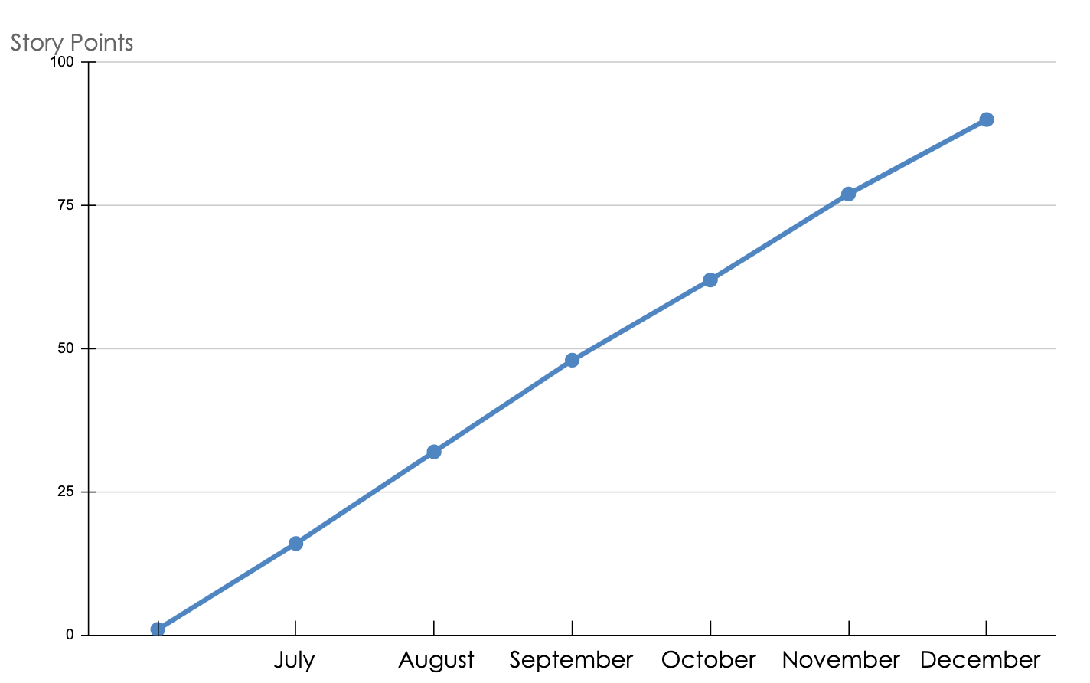
Burn Up Chart
SIMPLE
Milestone 6: Git repo is organized, CI/CD app working.
User Story: 8.2, 7.2, 8.1
Milestone 5: VCS passes test cases, and new merge conflicts resolved within 24 hrs
User Story: 2.1, 6.1, 7.1
Milestone 3: SVN repo cloned to and synced to local Git repo; AWS CodeCommit repository is configured and local Git repo shared to it
User Story: 2.2, 5.2, 6.2
Milestone 4: Git repos are all running and all files migrated, Git access controls set up and repository access is documented
User Story: 2.3, 3.2, 6.3
Milestone 1: Documentation of current SVN repository structure completed; Git Champion and Migration Lead identified; Configuration checklist/migration plan finalized
User Story: 1.1, 1.2, 3.1
Milestone 2: R&D team receives reference/training materials, and are familiar with Git commands
User Story: 4.1, 4.2, 5.1
^{[1]}
Average Velocity: 15 points
[1] Template: https://www.smartsheet.com/content/burn-up-chart-templates

Slide 37
Rework/Migration Cost Breakdown
AVERAGE
Cost Component | SVN Rework Description | SVN Cost Pain Points | SVN Total Cost | Git Migration Description | Git Cost Pain Points | Git Total Cost
IT Infrastructure | On Premise Servers- Maintenance Cost, Repurchase every 3-5 years with Installation | Server: $4500 Backup Server: $3100 Installation Cost: $700 x 2( server and backup server) Maintenance Cost: $600/month x 2 x 12 (server and backup server) | $23,400 | Cloud has become increasingly popular and secure and there are many Git hosting websites to choose from that have plugins for our third party tools. | AWS CodeCommit: $1.00/User per Month R&D Team Size: 25 Backup and archived: S3 Standard - Infrequent Access All Storage/Month - $0.0144 per GB Assume 1TB for S3 | $314.4 (year)
Labor | IT Consultant Services-Initial Assessment and reconfiguration that requires skills not available in our current department. | Initial Assessment: $25,000 Reconfiguration: $200,000 | $225,000 | We will have our own employees help with migration, those who are more knowledgeable in Git, software and infrastructure | Migration Team Size: 8 Avg Monthly Wage:$8,833.33 Migration Length: 3 months | $211,999.92
Training | Due to reconfiguration of our system, we’ll need to re-train our employees on the new system and workflows | Training Budget: $20,000 (Assuming familiarity with the SVN commands) | $20,000 | Initially, we’ll need to train the R&D team on the Git commands and how to use AWS CodeCommit. Project Managers and Product Managers will probably need to only know the basics, while developers and engineers will need further training. | Training budget: $28,000 | $28,000
[1] Git Migration Cost breakdown: https://aws.amazon.com/codecommit/pricing/
[2] Git Migration Cost breakdown:: https://aws.amazon.com/s3/pricing/?p=pm&c=s3&z=4
[3] Cost breakdown https://rdi-it.com/how-much-does-a-server-cost-for-a-small-business/#:~:text=Cost%20of%20maintaining%20the%20server&text=However%2C%20the%20upkeep%20process%20requires,%24150%2D%241%2C500per%20month.
[4 ] Cost breakdown: https://www.semanticscholar.org/paper/A-Return-on-Investment-as-a-Metric-for-Evaluating-Botchkarev-Andru/0fae5f76ebaca744e6848ce41df3fdcf59c2ba4a/figure/1
[5] Cost breakdown: https://www.servermania.com/kb/articles/how-much-does-a-server-cost-for-a-small-business#:~:text=The%20average%20cost%20to%20rent,3000%20for%20a%20small%20business.
^{[1][2][3][4][5]}

Slide 38
Return on Investment(ROI)
SIMPLE
Average R&D Yearly Budget: $6,000,000
Year | Budget Used for SVN Rework | Budget Used for Git Migration
1 (First year, where migration or rework takes place) | Total Cost of Rework: 23,400+ 225,000+ 20,000 (IT Infrastructure + Labor + Training) $268,400 | Total Cost of Migration: 314.4 +211,999.92+ 28,000 (IT Infrastructure+Labor+Training) $240,314.32
2 (A year after rework or migration initially took place) | Server Maintenance Cost: $13,200 | IT Infrastructure: $328.8 (AWS S3 and CodeCommit)
Year 1 Savings: (268,400-240,314.32)/268,400 = 10.46% savings on cost of SVN, save $28,085.68
Year 2 Savings: (13,200-328.8)/13,200 = 97.51% saving on cost of SVN, save $12,871.2
^{[1]}
[1] Return on Investment: https://www.bbgbroker.com/cost-of-employee-benefits-2022/

Slide 39
Return on Value (ROV)
SIMPLE
Distributed Development | A distributed development eliminates the need to always connect with a server, while allowing local changes. This allows more flexibility within the development environment. Before Covid, there were 0% remote workers, but post Covid, there are now 20% remote workers, which SVN does not support too well.^{[1]}
Increased Productivity | Git allows easier branching and merging, which can allow for easier code integration. Employees can merge code within seconds or minutes on git, unlike with subversion where there could be merging conflicts that could take two weeks with six developers to figure out[]. Moving from subversion to git will decrease unnecessary code review and debugging time due to merge conflict from 10% to 5%.
Predictable Delivery Timeline | Git allows for developers to work independently and merge when needed, which can lead to a more efficient, consistent delivery of code, reducing the Go to market time by 15%
Improved Data Protection and Recovery Capabilities | While SVN repositories will have a backup and recovery plan if the repository goes down, it is easier to recover everything using Git. The Git repository is distributed in local copies, so there is less to worry about if a failure occurs on the main repository. The main repository can be restored from one of the local copies.^{[2]}
[1]Spolsky, J. (n.d.). Subversion re-education. HgInit: Subversion Re-education. Retrieved April 23, 2023, from https://web.archive.org/web/20180909115459/http://hginit.com/00.html
[2]Stickman, N. (2023, March 9). Git Vs SVN: Pros and cons of each version control system. Linode Guides & Tutorials. Retrieved April 26, 2023, from https://www.linode.com/docs/guides/svn-vs-git/

Slide 40
Risk Assessment & Mitigation Plan
SIMPLE
Risk ID | Risk | Risk Description | Impact Description | Likelihood Level (Very low-1 to Very high-5) | Impact Level (Very low-1 to Very high-5) | Priority Level [Likelihood x Impact] (Higher number = Higher priority) | Mitigation Notes
01 | Native Git’s vulnerabilities [1] | Due to the OSS nature and widespread adoption, Git is prone to security vulnerabilities [58] | Impacts can range from unauthorized access to a complete system takeover [58] | 3 | 5 | 15 | System admin must stay up to date on known vulnerabilities and patch Git with the latest security updates as soon as they are released.^{[1]}
02 | Inaccurate access permission [1] | Poorly configured permissions can provide an access point to every Git repository on the server | Unauthorized access can lead to data breaches, and potential legal and financial repercussions | 2 | 4 | 8 | Define access roles on a per-repository basis to ensure only developers with valid access credentials are allowed to repository. ^{[1]}
03 | Lack of user adoption | Teams are discouraged from adopting Git due the steep learning curve and the need to change existing workflows, branching strategies, and collaboration practices | Adoption challenge can lead to reduced productivity, disrupted collaboration, or violations of governance and IT policies | 3 | 2 | 6 | Develop change management plan that outlines communication, documentation, and support mechanisms to help team members adapt to the new Git workflows and practices. ^{[2]}
[1] Katz, E. (2021, March 26). 8 Top Git Security Issues & What To Do About Them. Retrieved from https://spectralops.io/blog/8-top-git-security-issues-what-to-do-about-them/
[2] Expert Panel. (2022, March 11). Change Management: 13 Ways To Introduce New Technology, Retrieved from https://www.forbes.com/sites/forbeshumanresourcescouncil/2022/03/11/change-management-13-ways-to-introduce-new-technology/?sh=6af0a8906dc8

Slide 41
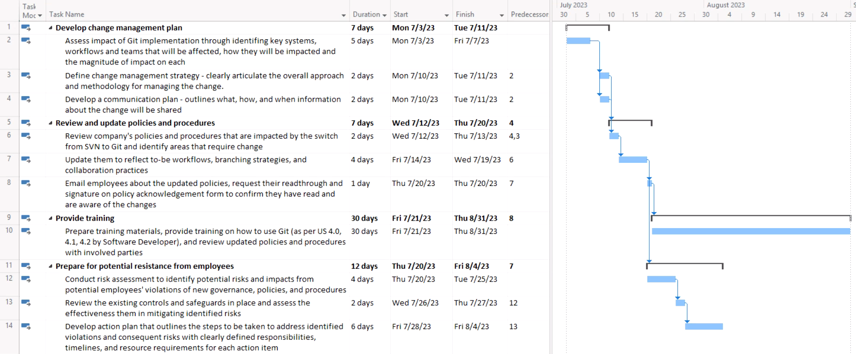
Detailed Mitigation Plan for Lack of User Adoption
SIMPLE

Slide 42
Data Breach Disaster & Response Plan
SIMPLE
Scenario:
Through social engineering method, a malicious actor obtains one of our developers’ credential information to access the central Git repository,
Using the compromised credential, the attacker gains unauthorized access to the repository and now has the ability to clone, pull, push, or modify the repository.
Impact:
The attacker can browse, download, or exfiltrate sensitive data from the repository, including source code, configuration files, credentials.
➠ Resulting in data exposure and data theft of sensitive intellectual property, trade secrets, and customer data.
The attacker can also maliciously modify the repository, introducing backdoors, malware, or other malicious codes to the codebase.
➠ Resulting in compromise the integrity and security of the software and system relying on the repository.

Slide 43
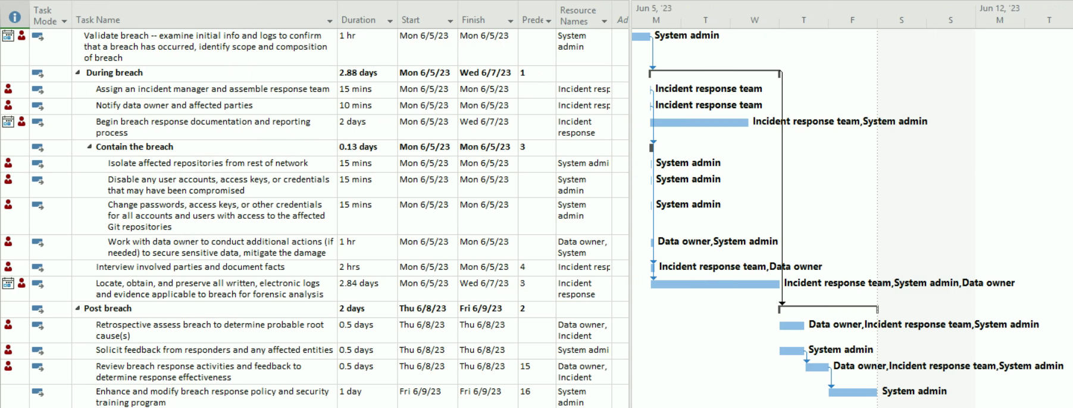
Data Breach Disaster & Response Plan [1]
AVERAGE
[1] U.S. DEPARTMENT OF EDUCATION. (2012, June). Data Breach Response Checklist. Retrieved from https://studentprivacy.ed.gov/resources/data-breach-response-checklist

Slide 44
03.c
Architecture and Design
TITLE
Overview of Architecture
High-Level Design
Low-Level Design

Slide 45
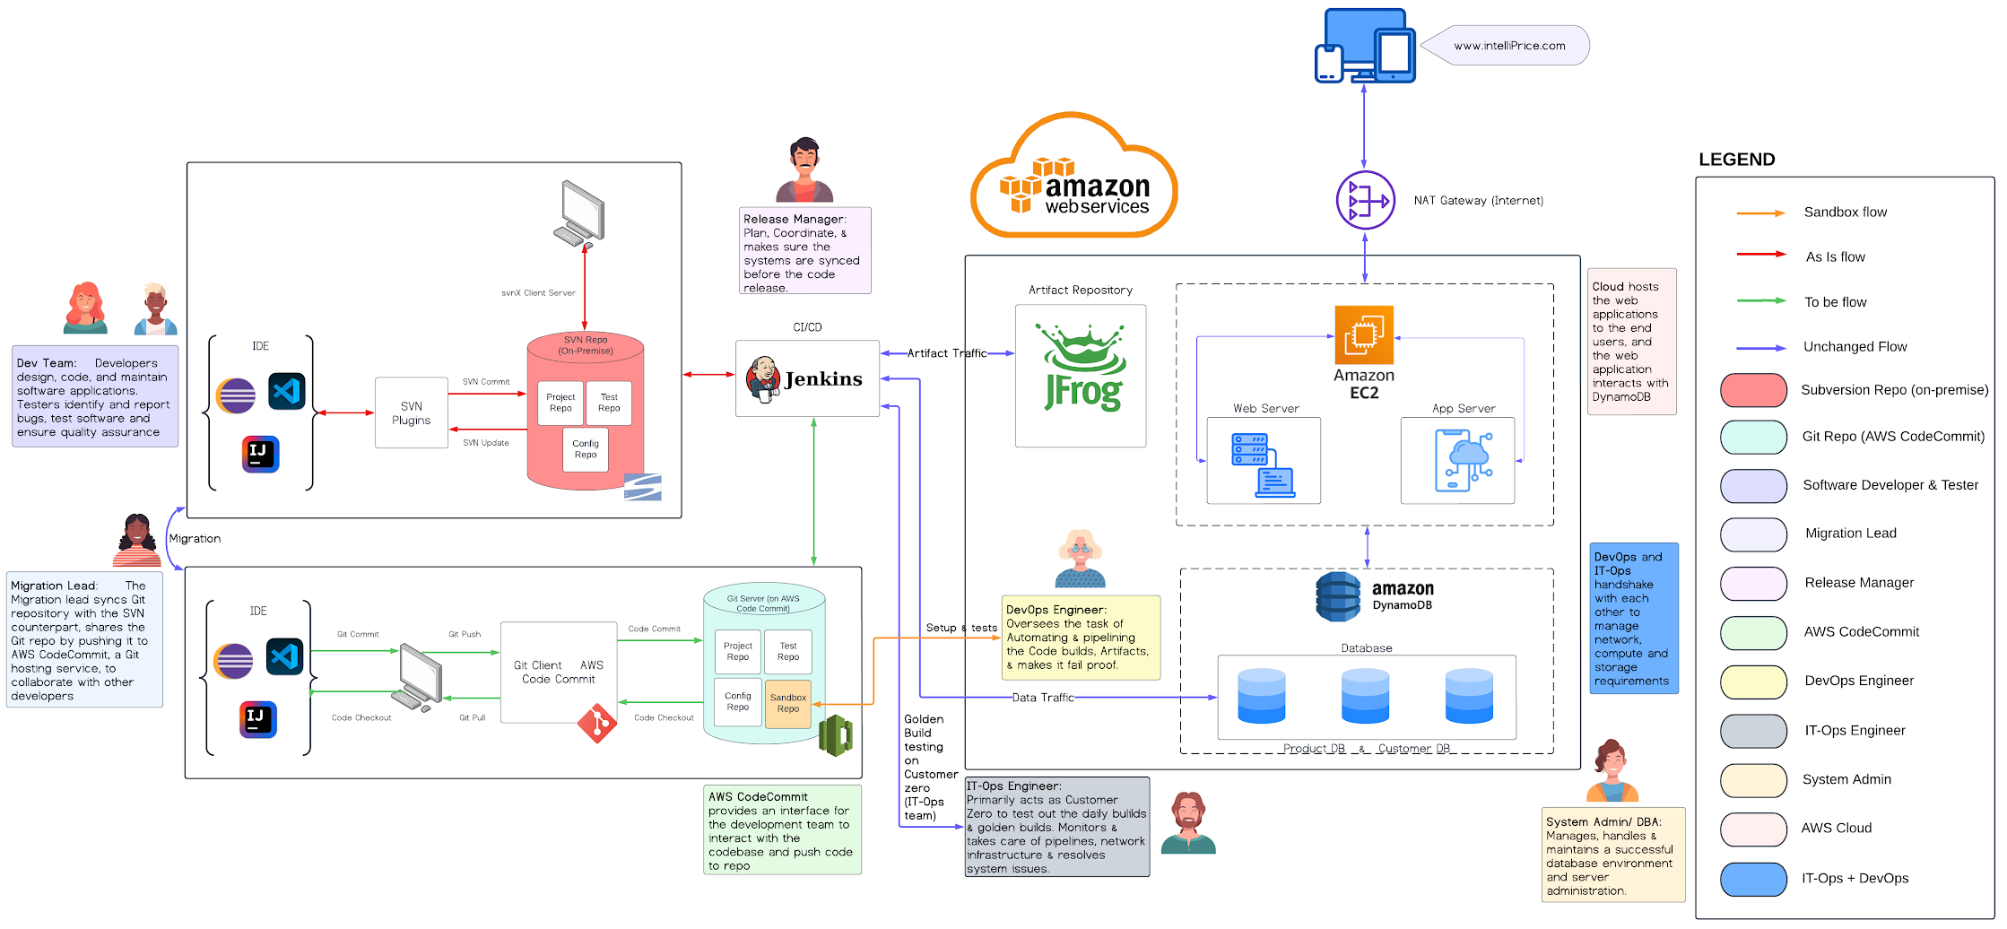
Architecture Map
AVERAGE
[2]
[1]
[3]
[4]
[5]
[14]
[13]
[12]
[6]
[7]
[8]
[9]
[10]
[11]
[1] AWS Image source: https://www.pngplay.com/wp-content/uploads/3/Amazon-Web-Services-AWS-Logo-Transparent-Free-PNG.png
[2] Devices Image Source: https://www.flaticon.com/free-icon/responsive_2777154?
[3] NAT Gateway Image Source: https://assets.vantage.sh/blog/nat-vpc-blog/nat-gateway.png
[4] JFrog Image Source: https://www.clipartmax.com/middle/m2i8G6K9b1H7m2Z5_jfrog-artifactory-logo/
[5] Amazon EC2 Image Source: https://automateinfra.com/2023/03/06/what-is-amazon-ec2-in-aws/
[6] Web Server Image Source: https://www.flaticon.com/free-icon/server_1832162?
[7] App Server Image Source: https://www.flaticon.com/free-icon/cloud-computing_9780579?
[8] DynamoDB Image Source: https://files.cdata.com/media/media/i3nhanbw/20191018-dynamodb-performance-0.png
[9] Database Image Source: https://www.flaticon.com/free-icon/database_1104982?
[10] Git Image Source: https://git-scm.com/downloads/logos
[11] CodeCommit Image Source: https://www.plutora.com/ci-cd-tools/version-control-tools/aws-codecommit
[12] Subversion Image Source: https://www.logo.wine/logo/Apache_Subversion
[13] Jenkins Image Source: https://dwglogo.com/jenkins/
[14] IDE Image Source: https://www.iconarchive.com/show/papirus-apps-icons-by-papirus-team/eclipse-icon.html

Slide 46
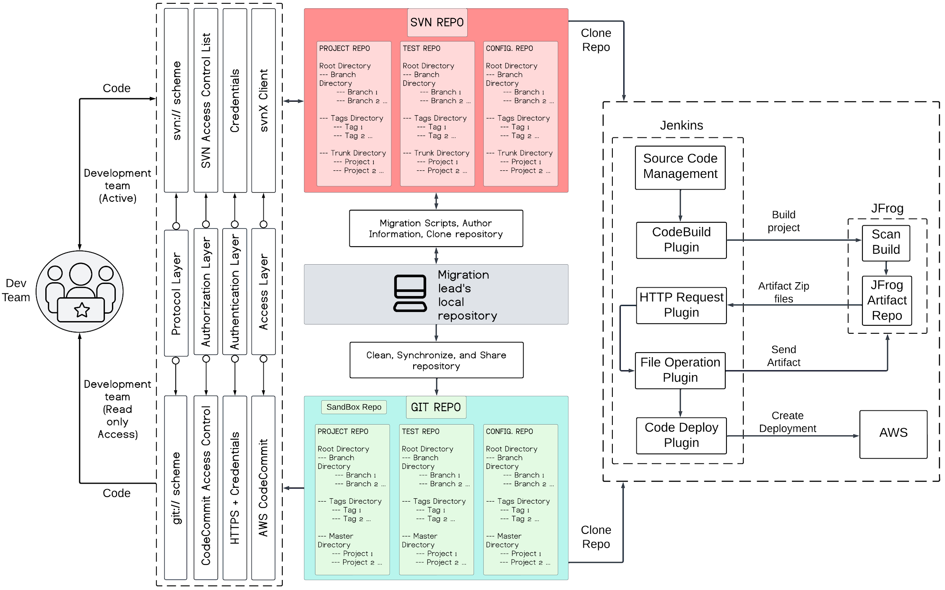
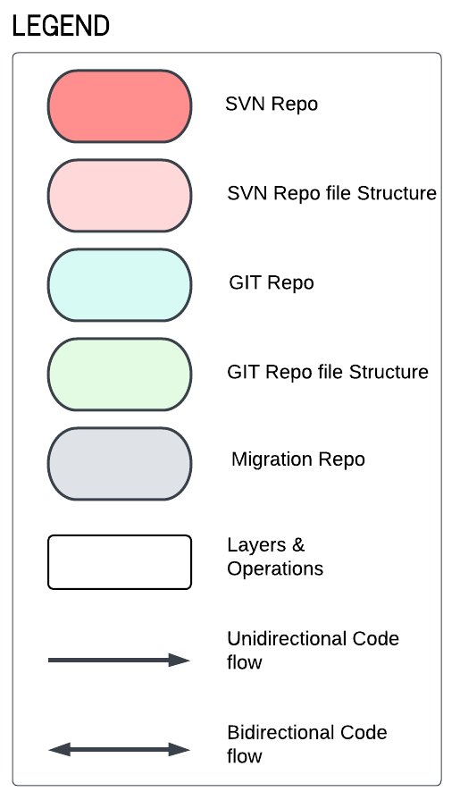
Architecture Diagram
AVERAGE
[1]
[1] Dev Team logo- https://www.flaticon.com/free-icon/team_4075912?term=team&page=1&position=35&origin=search&related_id=4075912

Slide 47
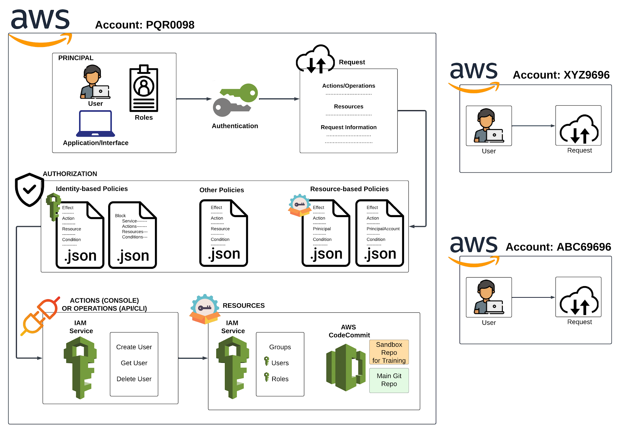
High Level Design
AVERAGE
[4]
[1]
[5]
[6]
[5]
[7]
[8]
[3]
[2]
[1] Authentication logo - https://iconduck.com/icons/7189/securityidentitycompliance-iam-long-termsecuritycredential
[2] Aws CodeCommit logo - https://vecta.io/symbols/12/aws-developer-tools/1/aws-codecommit
[3] AWS IAM logo - https://vecta.io/symbols/12/aws-developer-tools/1/aws-codecommit
[4] AWS logo - https://iconduck.com/icons/27090/aws
[5] User Icon - https://www.flaticon.com/free-icon/programmer_560277?term=user&page=1&position=22
[6] Authorization Icon - https://www.flaticon.com/free-icon/verified_2438078?related_id=2438080
[7] Actions Icon - https://www.flaticon.com/free-icon/plug-in_4429977
[8] Resources Icon - https://www.flaticon.com/free-icon/resources_5966044

Slide 48
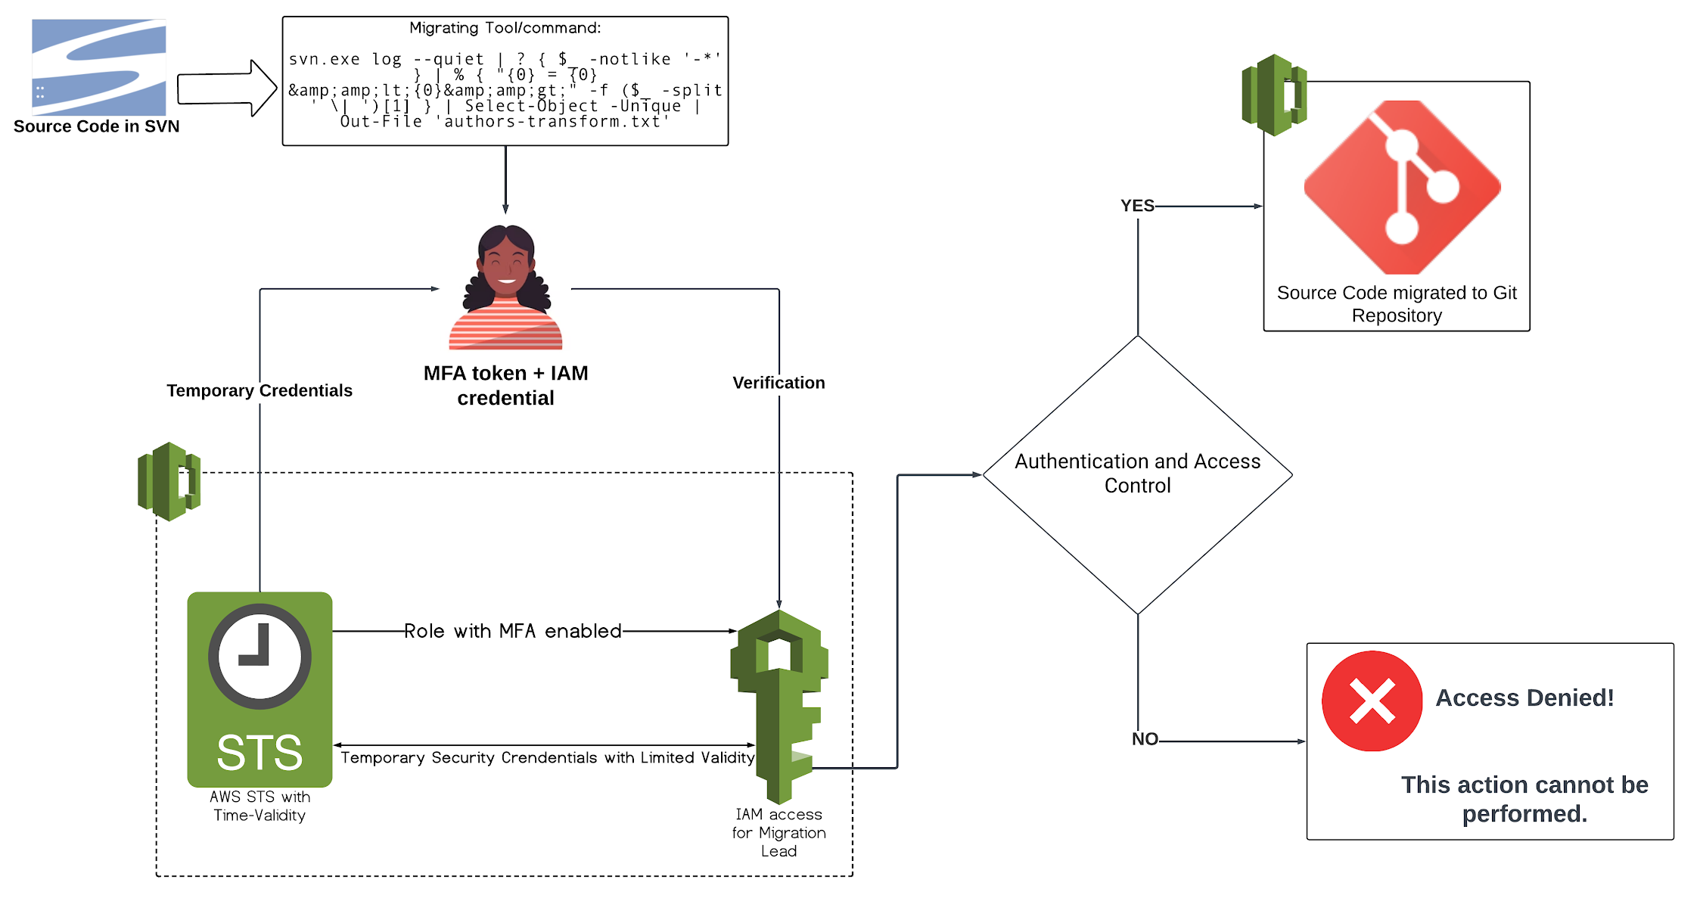
Low Level Design
SIMPLE
^{[2]}
^{[2]}
[4]
[3]
^{[1]}
[1] MFA authentication on AWS Codecommit - https://aws.amazon.com/blogs/devops/secure-aws-codecommit-with-multi-factor-authentication/
[2] Aws CodeCommit logo - https://vecta.io/symbols/12/aws-developer-tools/1/aws-codecommit
[3] AWS IAM logo - https://vecta.io/symbols/12/aws-developer-tools/1/aws-codecommit
[4] AWS STS logo - https://vecta.io/symbols/12/aws-developer-tools/1/aws-codecommit

Slide 49
03.d
Testing
TITLE
Testing Strategy
Testing Methodology
Success Factors & Metrics

Slide 50
Testing
SIMPLE
Overarching Goals [1]
Ensure that data (e.g., repos, commit history, etc.) are migrated from SVN to Git in a way that ensures data integrity and consistency.
Errors and bugs are identified and resolved before actual migration takes place.
Integration with other applications results in a stable architecture; CI/CD is functioning correctly.
User functional requirements in regards to system performance and capabilities are met.
Testing Strategy [2]
Customer Zero Testing: Our main focus is the actual migration; IT Ops and Dev Ops should be able to support the developer teams to resolve any issues that they have with Git and the associated applications (i.e., CI/CD pipeline, AWS CodeCommit, IDE’s, etc.). They should be the first customer of the new architecture in order to ensure successful migration and then customer satisfaction with the new architecture. Done through following this test plan:
 | Validation Testing | Functional Testing | Integration Testing | User Acceptance Testing
Phase 2: Customer Training and Support | ✔
Phase 3: Migration and Configuration | ✔ | ✔ | ✔ | ✔
Phase 4: Post-Migration Maintenance |  | ✔ |  | ✔
[1] https://www.datamigrationpro.com/data-migration-testing-strategy
[2] https://www.cio.com/article/194044/5-lessons-when-creating-a-customer-zero-program.html

Slide 51
Testing Methodology (1/2)
SIMPLE
Functional Testing [1]
Testing Tool(s): Git environment, CI/CD application, customized scripts
We want to test that Git meets both its stated functionality and our own defined functional requirements for the application.
Functional Requirement Example: Git should allow developers to create, manage, and merge multiple branches of their code as needed for new features.
Test Case Example: During our migration, we will test that we can create new branches from both existing branches, as well as from the main branch successfully. Our DevOps team and the Migration Lead should be able to understand branching so that they can support the developer teams when they begin to use Git.
Successful Outcome: The DevOps team will have a new branch created that has the proper naming, history, tracking information, and relationship with the main branch, and can be easily merged with the main branch when deemed appropriate.
Integration Testing [2]
Testing Tool(s): Git environment, CI/CD application, IDEs
Test that Git can successfully integrate with both our IDEs of choice as well as our CI/CD application, Jenkins.
Test Case Example: The DevOps team commits the code to AWS codecommit, where a Jenkins job is triggered to build the application, then executes the configured deployment steps to deploy the application to the AWS EC2 instance.
Successful Outcome: The application should deploy within 5-10 minutes if it is a small release, or within 10-15 minutes if it is a more complex release.
[1] https://www.microfocus.com/en-us/what-is/functional-testing#:~:text=Functional%20testing%20is%20a%20type,with%20the%20end%20user's%20expectations.
[2]https://www.techtarget.com/searchsoftwarequality/definition/integration-testing#:~:text=Integration%20testing%20%2D%2D%20also%20known,tested%20as%20a%20combined%20entity.

Slide 52
Testing Methodology (2/2)
SIMPLE
Validation [1]
Testing Tool(s): Git environment, customized scripts
We want to compare the SVN repository to the sandbox environment and the actual Git repository to ensure that the repositories are the same. (Binary File Comparison)
Test Case Example: DevOps Team would create their own scripts to compare the SVN repository to the Git repository and execute them, giving the different path files. Devops Team would then review the comparison report after execution and look for any discrepancies.
Successful Outcome: The SVN repository, Git repository and the sandbox environment are all the same, and have no discrepancies or variations between them.
User Acceptance Testing [2]
Testing Tool(s): Git environment, customized scripts
We want to ensure that any bugs identified when we go-live are logged, classified per our bug management policies, and then resolved. These bugs that are identified should be have low severity.
Test Case: Our developer teams will attempt to access repositories that they should not have access to per the governance guidelines set by the System Admin.
Successful Outcome: Every member of the developer teams should only be able to access the repositories that they have been given explicit access to. Any unauthorized access will be reported to the System Admin and the DevOps team for quick resolution.
[1]https://decemberlabs.com/blog/validation-testing/#:~:text=Validation%20testing%20is%20the%20Quality,product%20meets%20its%20acceptance%20criteria.
[2] https://www.guru99.com/user-acceptance-testing.html

Slide 53
03.e
Release
TITLE
Release Roadmap
Release Criteria
Release Checklist
Branch Management
Bug Management

Slide 54
Release Criteria
SIMPLE
CRITERIA | WHAT | WHY | HOW
Successful Compilation and Build for all Platforms | Git must compile and build without errors for Windows, macOS, and Linux platforms using the latest stable versions of compilers and build tools. | Since our company requires cross-platform compatibility, we need to ensure that the Git software is compatible and functional across different operating systems. Any friction about compatibility may hinder our release process since some of our customers will suffer. | Development Lead will conduct comprehensive build tests on each platform using automated build scripts and continuous integration systems. Any build errors or compatibility issues must be addressed and resolved before the release.
Zero High Priority and Critical Severity Bugs | No high priority or critical severity bugs should be open in the bug tracking system at the time of release. | High priority and critical severity bugs can significantly impact the stability, security, and functionality of the system, posing risks to customers. | QA Lead will implement a robust bug tracking system and conduct regular bug triaging sessions. High priority and critical bugs must be addressed and resolved before the release.
High-Quality Testing and Acceptance | Achieve a pass rate of at least 95% for critical functional tests outlined in the test plan, as well as gather positive customer feedback during the user acceptance testing phase. | Effective testing ensures that the software meets functional requirements, maintains stability, and delivers a positive user experience. | QA Lead will design comprehensive test plans covering all critical functionality, execute rigorous testing procedures, and involve QA experts to ensure thorough test coverage. Customer feedback should be actively sought and incorporated into the release decision.
Bug Discovery and Resolution | Reduce the number of open bugs by 50% over the last three weeks leading up to the release. | Reducing the number of open bugs indicates continuous improvement in the software's stability and reliability, minimizing customer disruptions. | Release Manager will regularly monitor and track open bugs, conduct root cause analysis for recurring issues, and assign dedicated resources to resolve them. The trend should show a steady decrease in open bugs leading up to the release.
Customer Adoption and Success | Achieve a minimum of 80% customer adoption by Customer Zero, as measured by the number of active customers using the migrated Git system and providing positive feedback. | Ensuring that Customer Zero fully adopt and benefit from the software leads to long-term business relationships and positive referrals. A low adoption rate may signal low customer satisfaction and eventually may cause release delays. | Customer Success team will ensure smooth adoption of the Git system, address any challenges faced by Customer Zero, provide comprehensive documentation and training resources, and actively measure customer satisfaction and usage metrics.
[1]
[2]
[1] https://www.jrothman.com/articles/2002/03/release-criteria-is-this-software-done
[2] https://karlwiegers.medium.com/are-we-there-yet-defining-product-release-criteria-9fa7e66870e9

Slide 55
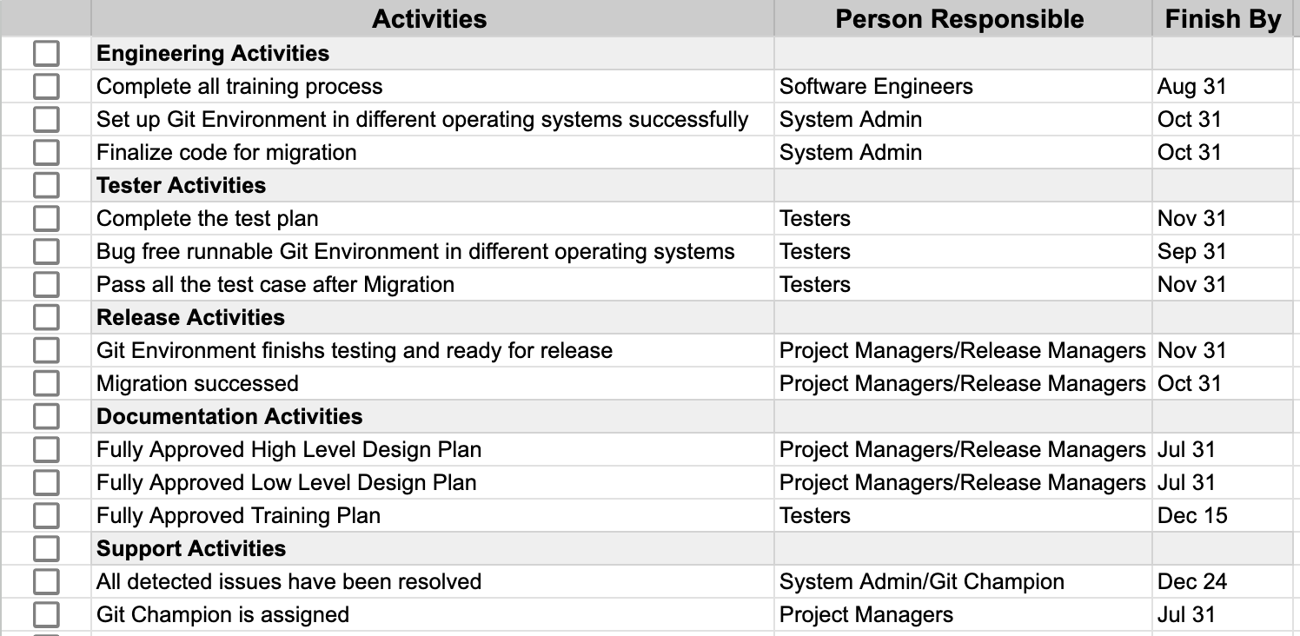
Release Checklist [1][2]
SIMPLE
[1]https://www.indeed.com/career-advice/career-development/release-management-checklist#:~:text=A%20release%20management%20checklist%20is%20a%20document%20that%20details%20all,to%20quality%20checks%20and%20delivery.
[2]https://www.smartsheet.com/sites/default/files/IC-Release-Management-Checklist-Template-10615_PDF.pdf

Slide 56
Release Plan
[1] https://www.atlassian.com/blog/agile/product-managers-guide-release-planning
[2] https://en.wikipedia.org/wiki/Software_versioning
AVERAGE
PHASES | ALPHA |  |  | BETA |  | GOLDEN BUILD
Milestones
Testing
Release Timeline
Functional Testing is used to create the Minimum Viable Product. Git is ready to be used in all operating systems.
All glitches and bugs related with the integration and functionality are fixed per the feedback from Validation Testing and Functional Testing
IP checks are conducted to ensure that all code and data in the golden build is compliant with the project's IP requirements
Release of the beta version met with a wider audience. Customer Zero now includes higher number of users. Git is working properly with the desired functionality.
Feedback from Functional Testing is implemented into the system. Software has been tested for security vulnerabilities and has been found to be secure.
All of the features and functionality have been implemented and are working as expected. All stakeholders have agreed that the golden build is ready for release.
The maintenance plan for the golden build is complete and has been approved by the product owner and the development team.
Validation Testing
Validation Testing
Validation Testing
Validation Testing
Validation Testing
Functional Testing
Functional Testing
Functional Testing
Functional Testing
Functional Testing
Functional Testing
Functional Testing
User Acceptance Testing
User Acceptance Testing
User Acceptance Testing
User Acceptance Testing
User Acceptance Testing
User Acceptance Testing
Integration Testing
Integration Testing
Integration Testing
Integration Testing
Feedback end date
Nov 13, 2023
Feedback end date
Dec 4, 2023
Feedback end date
Dec 18, 2023
1.0.0
[2]
Sept 11, 2023
1.1.0
Sept 29, 2023
1.1.1
1.2.0
Oct 16, 2023
Oct 30, 2023
1.2.1
Feedback end date
Sept 6, 2023
Nov 20, 2023
1.3.0
1.3.1
Feedback end date
Sept 22, 2023
Feedback end date
Oct 9, 2023
Feedback end date
23, 2023
Dec 11, 2023
Dec 24, 2023
[1]

Slide 57
Branching Management
SIMPLE
Create a Branching Strategy [1]
Feature Branching: Each new feature is developed in its own branch, keeping the main branch clean and stable. When a feature is complete, it's merged back into the main branch. Gitflow
Release Branching: Creating a new branch for new releases.
Hotfix Branching: Creating a new branch for urgent fixes.
Establish Naming Conventions [1]
Consistent naming for branches is crucial for clarity and organization. A common convention is to use category prefixes
Manage Lifespan of Branches [1]
Branches should have a limited lifespan to keep the repository manageable. Once a feature is merged into the main branch and deployed, the corresponding feature branch should be deleted.
Conduct Regular Code Reviews [1]
Before merging branches, conduct code reviews to ensure code quality and consistency. This can be facilitated with pull requests in platforms like GitHub or GitLab.
Merge Changes Frequently [1]
Regularly merge changes from the main branch into feature branches to avoid massive merge conflicts later on. This is often referred to as keeping branch "up to date".
Utilize Pull Requests [1]
Use pull requests for merging code. This ensures code review and discussion can happen before changes are added to the main branch.
Automate Testing [1]
To ensure code in branches doesn't break the application, set up automated testing that runs whenever changes are pushed to any branch.
[1] https://www.atlassian.com/git/tutorials/comparing-workflows/gitflow-workflow

Slide 58
Bug Management
SIMPLE
“Priority” will have precedence over “Severity” unless Severity level is Critical then “Severity” supersedes
BUG CLASSIFICATION
BUG CLASSIFICATION
[1]
BUG TRACKING IN JIRA [2]
Priority
(Business Impact)
Severity
(Technical Impact)
1. Capture Bug
2. Prioritize & Assign
3. Resolve & Test
4. Close
High
Medium
Low
Critical
Major
Minor
Low
Jira provides customization options that allow us to tailor bug reports to our specific needs. Our bug reports will contain the following details: [3]
Bug ID: Assigned automatically by Jira.
Project: The project the bug is associated with
Status: Created automatically upon creation of bug report. Default status is "To Do".
Summary: A quick description of the bug.
Description: The more detailed the description is, the easier it is to identify the solution.
Severity: An estimate of the bug’s technical impact
Priority: An estimate of the bug’s business impact
Attachment: Any screenshots, or documentation that can assist in identifying and fixing the bug.
Assignee: The person assigned to handle this issue.
High: Major business impact, often tied to revenue, expenses, or customer satisfaction
Medium: Noticeable business impact, but do not cause severe disruptions or major financial losses
Low: Minor or no business impact
Critical: Bug capable of triggering complete system shutdown
Major: Bug capable of collapsing large parts of the system
Minor: Results in some unexpected or undesired behavior, but not enough to disrupt system function
Low: Bug won’t result in any noticeable breakdown of the system
Always will be addressed first
Examples of Bug Classification
Source code loss when force pushing
Intermittent branch corruption during remote push
Critical
SEVERITY
Slow performance during large repository cloning
Spelling error in error message
Low
[1] https://www.browserstack.com/guide/bug-severity-vs-priority
[2] https://www.idalko.com/jira-bug-workflow/
[3] https://www.instabug.com/blog/jira-bug-reporting-tool
High
Low
Always will be addressed last
PRIORITY

Slide 59
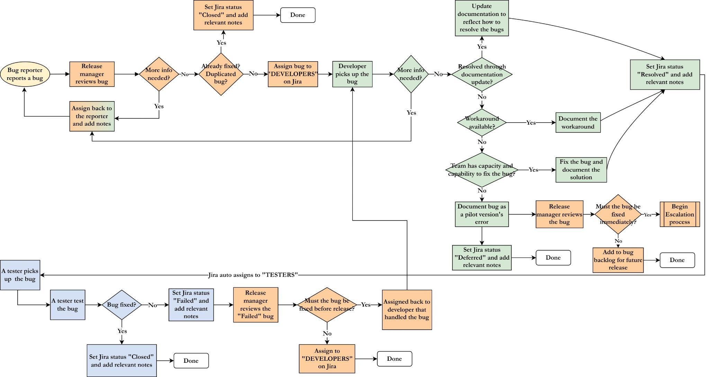
Bug Management Workflow
AVERAGE
Legend:
Bug Reporter
Release Manager
Software Developer
Software Tester

Slide 60
Thanks!

Slide 61
04
Appendix
TITLE

Slide 62
Proposed Solution
SIMPLE
Business Objective: Improve collaboration amongst developers, maintain productivity with remote work, put out timely releases of software updates and bug patches, and reduce project costs.
[1]
Criteria | Subversion (SVN) | Git
Performance and Scalability | SVN can be slow with large repositories and struggles with scalability due to its central repository model. | Git can handle large repositories and is highly scalable due to its distributed nature. Git’s performance is often faster than SVN, especially for large repositories
Work Disruptions/ Single Point of Failure | SVN as a central repo model can be a single point of failure. If the central repository goes down, developers cannot make changes until it’s back up. | Git’s distributed nature allows developers to have a full copy of the repo on their local machines and continue their work even if the central repo goes down. This minimizes work disruptions and eliminates a single point of failure.
Collaboration and Streamlined Development | SVN allows multiple users to work on the same file but can result in conflicts that must be resolved manually. | Git’s branching and merging capabilities make it easier to manage parallel development and collaborate effectively. Developers can work on their own branches and merge changes into the main branch when ready.
Increase in Project Costs | SVN has a lower initial cost, as it is simpler to set up and use. However, it can be more expensive in the long run due to the potential for work disruptions, conflicts, and slower performance. | Git may have a higher initial cost, as it requires more training and migration efforts. However, in the long run , Git ican be, more cost-effective due to its scalability, performance, and collaboration capabilities.
[1] SVN vs Git: Which Version Control System Should You Use?, Nathaniel Stickman, March 3, 2023. Retrieved from: https://www.linode.com/docs/guides/svn-vs-git/

Slide 63
SWOT Analysis
SIMPLE
S
W
O
T
Strengths
Weaknesses
Opportunities
Threats
Larger community of users and resources available
Distributed nature allows for greater flexibility and easier collaboration
Better branching and merging capabilities
Better support for handling large repositories
Steeper learning curve
Distributed nature can lead to confusion
The migration process can be time-consuming
Command line interface may be intimidating for some users
Git's distributed nature can lead to potential security risks
More efficient collaboration between team members.
More likely to be supported by other continuous integration and deployment tools
Exploring new tools such as the use of Git submodules or Git hooks
More experimentation and innovation in the development process
The migration process may lead to disruptions
The steeper learning curve may decrease productivity
Additional resources for training and support can impact the company's budget

Slide 64
Benefits
SIMPLE
01
Performance
Compared to other version control systems, Git is highly efficient and dependable. It allows for simple committing of new code changes, easy comparison and merging of version branches, and optimization of code for improved performance.
02
Security
The cryptographic algorithm SHA1 is used to secure both the file contents and the relationships between files, directories, tags, commits, and versions in Git.
03
Flexibility
Git has a distinctive design that facilitates tagging and branching operations, and it maintains a comprehensive record of every action performed by the user as an essential aspect of the "change" history.
04
Wide acceptance
When compared to other VCS Git is the most widely accepted system owing to its universally accepted usability and performance standards.
05
Quality open source project
The quality of open-source software shared on Git undergoes intense scrutiny numerous times, and many businesses nowadays rely significantly on the code quality available on Git.
^{[1]}
[1] What is Git? What benefits does Git offer?. 2018, September 13. https://guide.quickscrum.com/git-guide

Slide 65
Key Features of Git
SIMPLE
Feature Branch Workflow
Git branches are cheap and easy to merge.
Distributed Development
Instead of a working copy, each developer gets their own local repository, complete with a full history of commits.
Faster Release Cycle
Pull Requests
Pull requests not only make it easier for project leads to keep track of changes, but also let developers initiate discussions around their work before integrating it with the rest of the codebase.
Community
It’s easy to leverage 3rd-party libraries and encourage others to fork your own open source code.
[1]
[1] Why Use Git for Your Organization. https://www.atlassian.com/git/tutorials/why-git

Slide 66
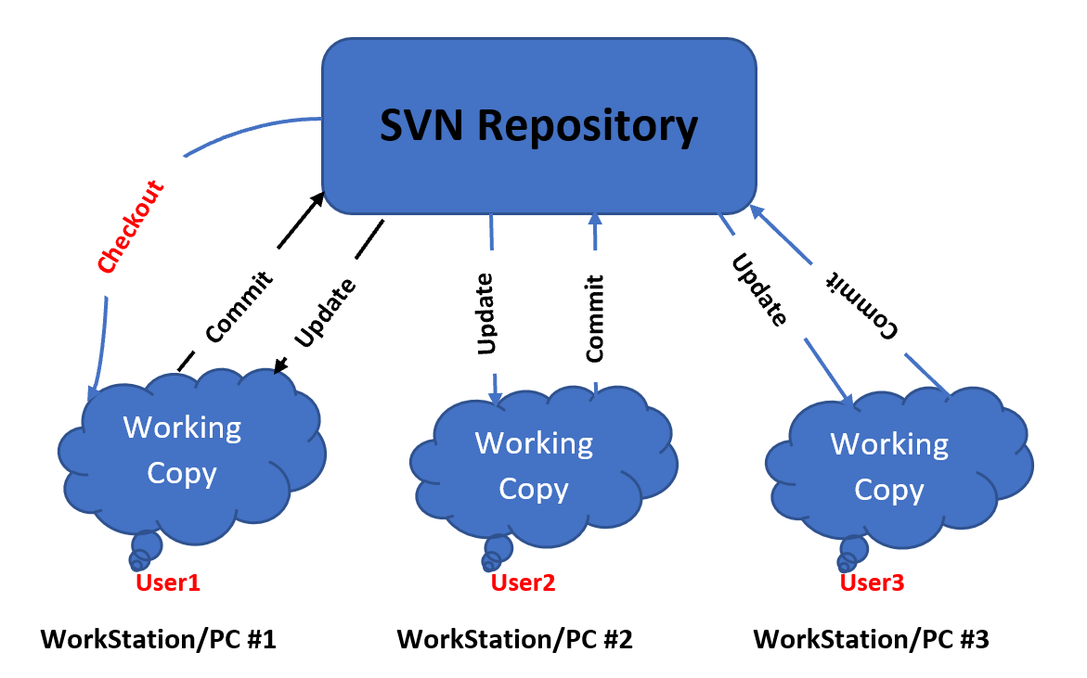
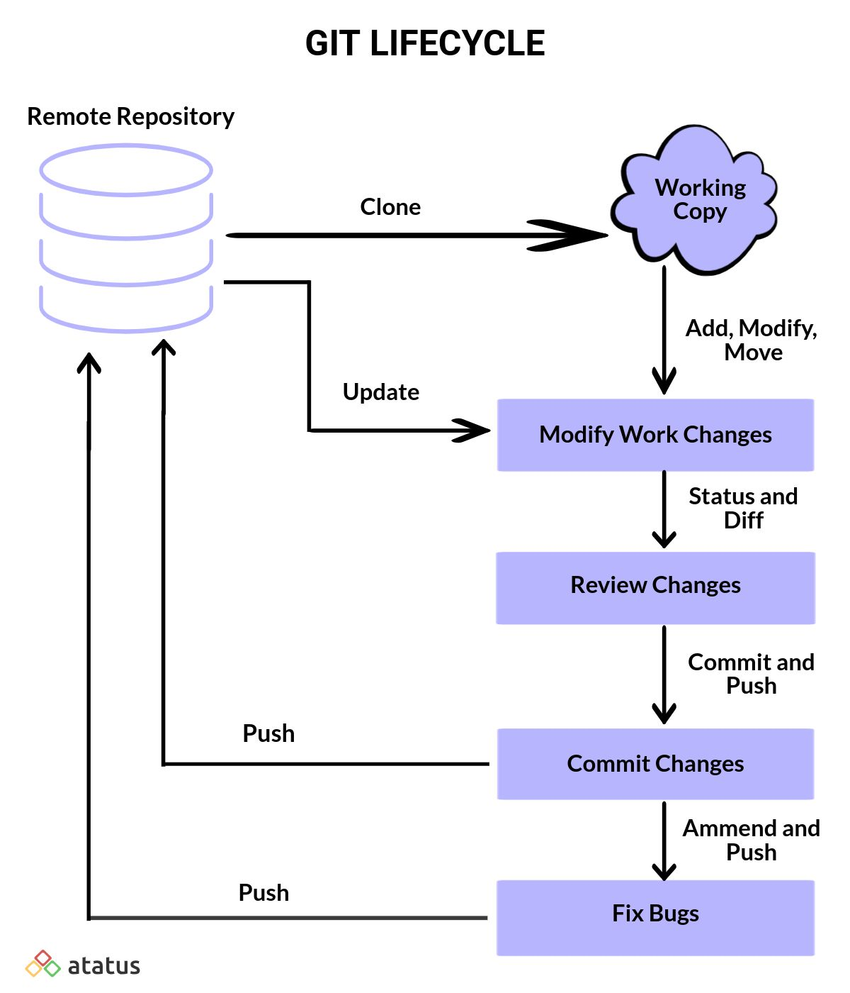
Current Workflow with SVN
New Workflow with Git
SIMPLE
[1]
[2]
IntelliPrice developers with SVN currently:
Update local copy on machine with recent version of central repository and make changes
Branches created as directories inside of repository
Commit changes to central repository infrequently due to pains of SVN merges, leading to working copies diverging from central repository
Have to pause work to smooth out merge conflicts with one another
Pause work if central repository experiences downtime
IntelliPrice developers with Git would:
Clone the remote repository locally to work off of
Work on scripts and commit to local repository as many times as they want without worrying about main repository
Not be able to override official commits to the main repository due to Git’s workflow, eliminating merge conflicts
Be able to continue to work in the case of sudden connection loss to the central repository
[1] Image from Basic Workflow in Subversion (SVN) – Getting Started Tutorials. April 04, 2022. Retrieved from: https://www.devopsschool.com/blog/basic-work-cycle-in-subversion-svn/
[2] Image from A Complete Guide to Use Git for Beginners. June 22, 2021. Retrieved from: https://www.atatus.com/blog/git-tutorial-for-beginners/

Slide 67
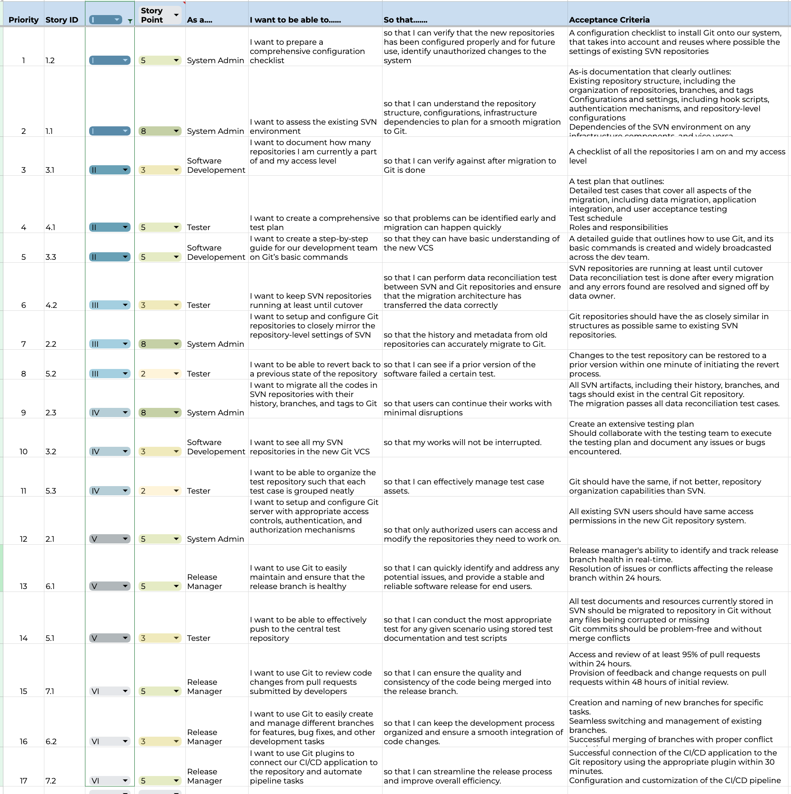
Product Backlog
SIMPLE

Slide 68
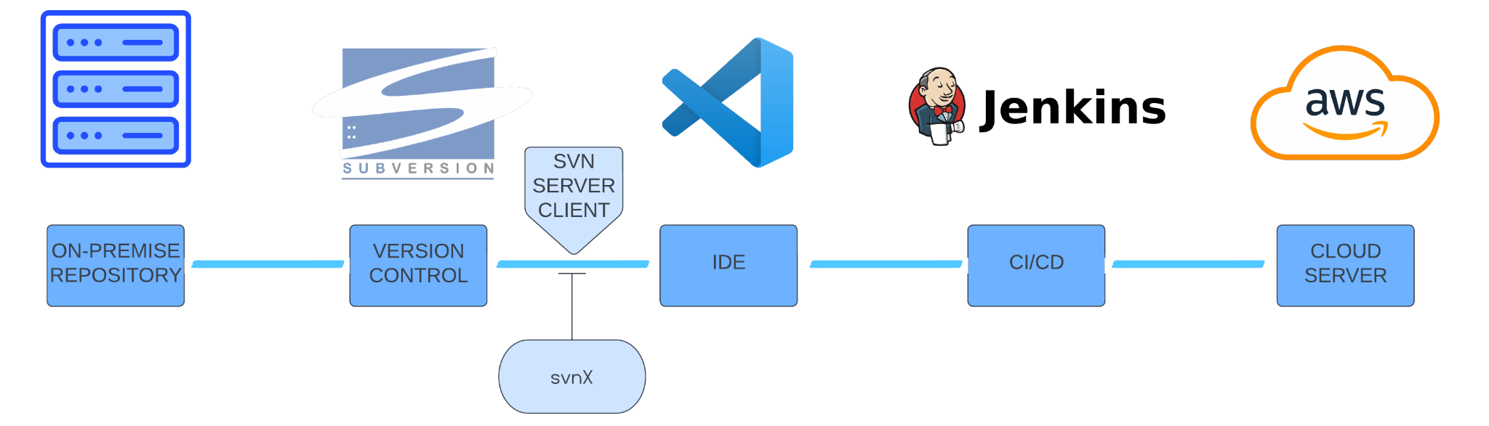
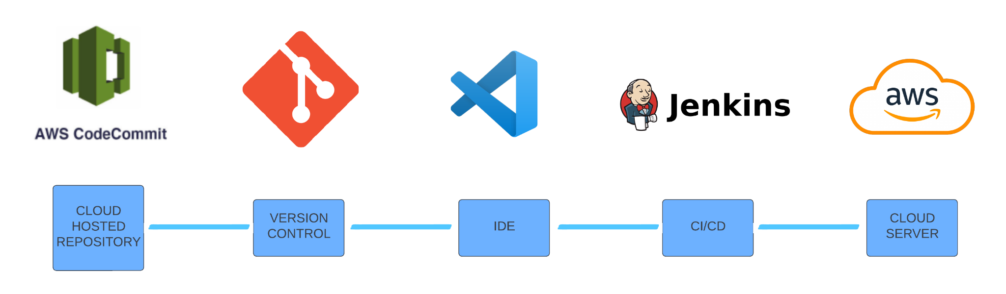
Architecture
SIMPLE
[1]
[2]
[3]
[5]
[4]
AS-IS
[6]
[7]
[3]
[5]
[4]
TO-BE
[1] Repository Image source: https://www.flaticon.com/free-icon/data-center_8894889
[2] SVN Image source: https://www.logo.wine/logo/Apache_Subversion
[4] Jenkins Image source: https://dwglogo.com/jenkins/
[6] AWS CodeCommint image source: https://www.plutora.com/ci-cd-tools/version-control-tools/aws-codecommit
[3]VS Code Image source: https://commons.wikimedia.org/wiki/File:Visual_Studio_Code_1.35_icon.svg
[5] AWS Image source: https://logos-world.net/amazon-web-services-logo/
[7]Git Image Source : https://git-scm.com/downloads/logos

Slide 69
Data Breach Disaster & Contingency Plan
SIMPLE
Mitigation Plan (proactive measures to minimize the risk):
Establish and implement a written data breach response policy.
Provide frequent privacy and security awareness trainings, and conduct regular simulated attacks to test effectiveness of those trainings ^{[1]}
Conduct regular security audits to identify and address any potential weaknesses or misconfigurations ^{[1]}
Review information systems and data and identify where trade secrets, PII, and other sensitive information reside ^{[1]}
Stay up-to-date with the latest security patches and updates ^{[1]}
[1] Blit, R. (2022, May 31). GitHub Security Best Practices Your Team Should Be Following. Retrieved from https://www.legitsecurity.com/blog/github-security-best-practices-your-team-should-be-following

Slide 70
Return on Value(ROV)
Cost of Unnecessary Rework Avoided per Year
AVERAGE
Average percentage of time spent on code review and debugging due to merge conflicts with SVN
Average percentage of time spent on code review and debugging due to merge conflicts with GIT
Rework on code review and debugging due to merge conflicts
Percentage of Time Spent on Unnecessary Rework With GIT
Percentage of Time Spent on Unnecessary Rework With SVN
R&D Staff Size
Average Salary
x
=
x
-
$132,500
=
25
x
$106,000
x
10%
-
5%
^{[1][2]}
[1] Return on Value referenced from : https://www.perforce.com/blog/vcs/subversion-price-subversion-free
[2] DORA Devops Research and Assessment. (2017). Forecasting The Value Of DevOps Transformations Measuring ROI of DevOps[White paper]. Crown. https://services.google.com/fh/files/misc/dora_devops_roi_whitepaper.pdf

Slide 71
Return on Value(ROV)
Development and coding for a typical project can take around 4-9 months. A simple 5 minute merge on subversion can take two weeks to fix. Due to this, our company needs to merge often, have multiple debugging and code review sessions, and just handle conflicts as they come along which can make projects longer. This can be reduced by which can be reduced by Git’s merging and branching solution.
AVERAGE
Hours potentially saved per day per R&D employee using Git:
Hours potentially saved per day using Git with the whole R&D Team:
Hours potentially saved per week:
Hours potentially saved per month:
5 hours x 5 days= 25 hours
5 hrs x 22 business days = 110 hours
.20 hours or around 12 min a day
.20 x 25 (R&D Team)= 5 hours
[1]
[1] https://github.blog/2022-12-20-increase-developer-productivity-save-time-on-developer-onboarding-and-drive-roi-in-2023/

Slide 72
Change Management & Enablement
SIMPLE
Step | Objective
Step 1: Listing Reasons for Change | Justification for migration is outlined, scope of change is assessed, and identify processes, policies, and roles within the company that will be affected by the change
Step 2: Identify Stakeholders | Identify which functional groups will be affected by the change, and communicate the necessity for change to them; send out communications, hold meetings, and hold live sessions demonstrating the Git environment and its features and secure support for change
Step 3: Put Together Change Management Team | Identify those within company who will be needed to implement the change (Release Manager, Tester, System Admin, Software Developer), and also secure executive sponsorship
Step 4: Prepare Communications and Training Materials | Begin to draft and send out company-wide communications about the planned change and the need for change; begin putting together training materials.
Step 5: Change Familiarity and Reinforcement | End users begin training to become more familiar with Git environment; user feedback is solicited; Understand challenges in migration and use information to improve the migration strategy
[1]
[1] https://www.productplan.com/glossary/change-management/

Slide 73
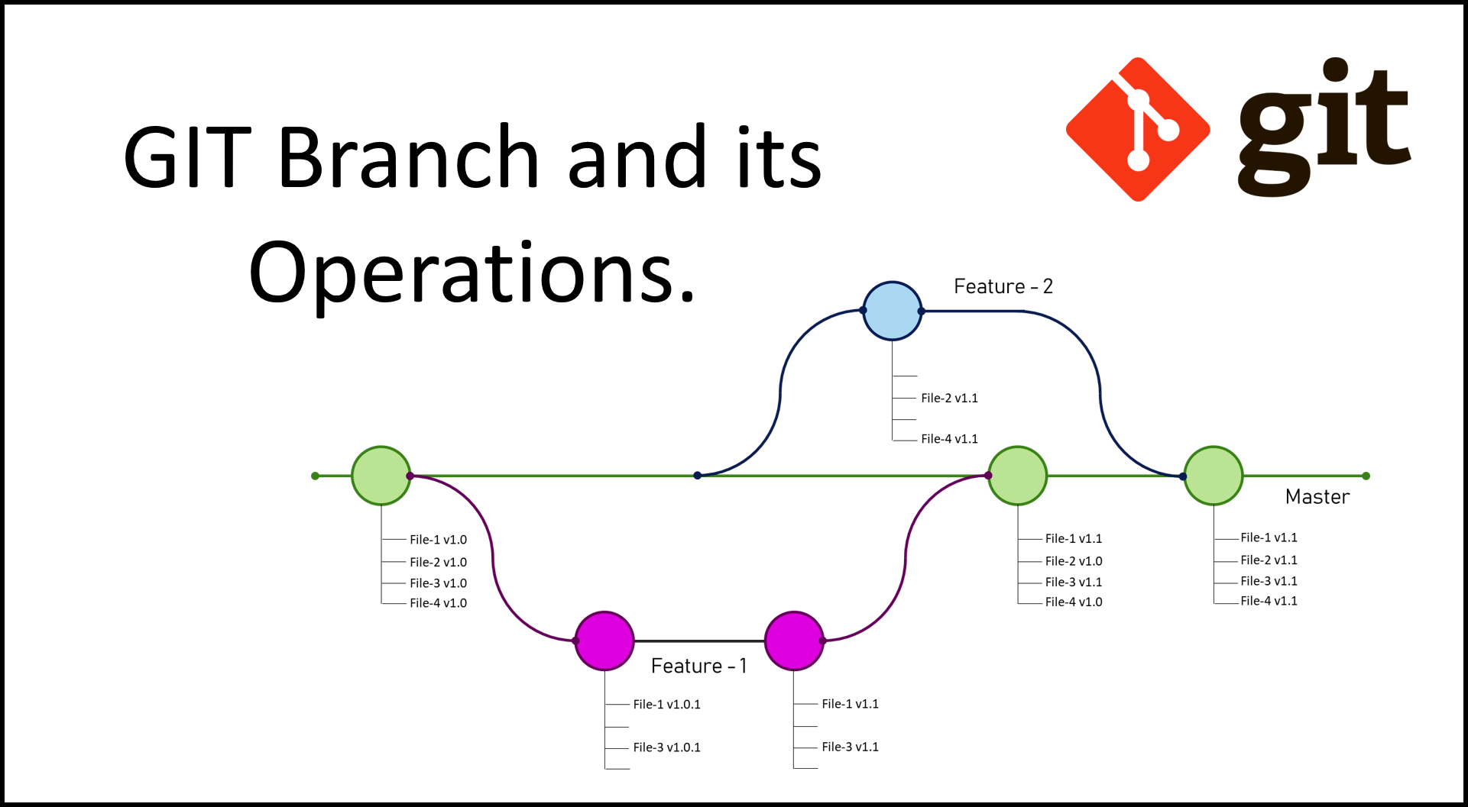
SIMPLE
[1] https://www.atlassian.com/git/tutorials/comparing-workflows/gitflow-workflow
[1]

Slide 74
Feature Branching
SIMPLE
Creating a Feature Branch in Git [1]
When starting a new feature, a separate branch is created in Git to isolate the development of this feature from the main branch.
Development and Committing in the Feature Branch [1]
All changes pertaining to the new feature are committed to this separate branch in Git. This allows multiple features to be developed in parallel without conflict.
Pulling from the Main Branch Regularly [1]
It's necessary to regularly pull changes from the main branch into the feature branch. This helps keep it up-to-date with any critical updates made to the main branch while the feature is being prepared.
Code Review and Testing in Git [1]
Once a feature is completed in its branch, it is subject to code review and testing before being merged into the main branch. Git's pull request mechanism often facilitates this process, allowing for an efficient review of the changes.
Merging the Feature in Git [1]
After passing review and testing, the feature branch is merged into the main branch in Git. Git's merge process effectively combines the changes with the main codebase while preserving the commit history.
[1]https://nvie.com/posts/a-successful-git-branching-model/

Slide 75
Release Branching
SIMPLE
Creating a Release Branch in Git [1]
Prior to a new production release, a separate branch is created in Git from the main branch. This "release" branch will include all features intended for the upcoming release.
Development and Committing in the Release Branch [1]
Any final adjustments, such as bug fixes, documentation updates, and final testing, are committed to this separate release branch. This ensures that the main branch is free for continued development of future features.
Pulling from the Main Branch Regularly [1]
It's necessary to regularly pull changes from the main branch into the release branch. This helps keep it up-to-date with any critical updates made to the main branch while the release is being prepared.
Code Review and Testing of Release Branch [1]
The release branch is subjected to extensive code review, testing, and quality assurance processes to ensure that it is ready for production.
Merging the Release Branch in Git [1]
Once the release branch has passed all checks and is ready for deployment, it is merged into the main branch and the production branch. Git's merging process effectively combines the changes with both the main and production codebases while preserving the commit history.
[1]https://nvie.com/posts/a-successful-git-branching-model/]

Slide 76
Hotfix Branching
SIMPLE
Creating a Hotfix Branch in Git [1]
When a critical issue is found in the production environment, a separate "hotfix" branch is created in Git from the production branch. This isolates the development of the fix from both the main and production branches.
Development and Committing in the Hotfix Branch [1]
The fix for the critical issue is developed and committed in this hotfix branch, keeping the other branches unaffected and ready for ongoing development and releases.
Pulling from the Main Branch Regularly [1]
It's good practice to pull changes from the production branch into the hotfix branch regularly. This ensures the hotfix branch is always aligned with the current production environment.
Code Review and Testing of Hotfix Branch [1]
The hotfix branch undergoes code review and testing to verify that the fix resolves the issue and doesn't introduce new problems. Git's pull request mechanism often facilitates this review process.
Merging the Hotfix Branch in Git [1]
Once the fix has been reviewed and tested, the hotfix branch is merged back into both the production and main branches. Git's merge process combines the changes with the main and production codebases while preserving the commit history.
[1]https://nvie.com/posts/a-successful-git-branching-model/

